Slide 1
Sirat Of The PROPET (SAW)
BY: Ahmed Elzeiny
LIFE IN MAKKAH
Part 1

Slide 2
Every mother is happy to have a baby but Aminah had another reason to be happy!!! She had a dream….
What was that???
WE warn you of an upcoming Son named MOHAMED
He will be the leader of mankind
Aminah…

Slide 3
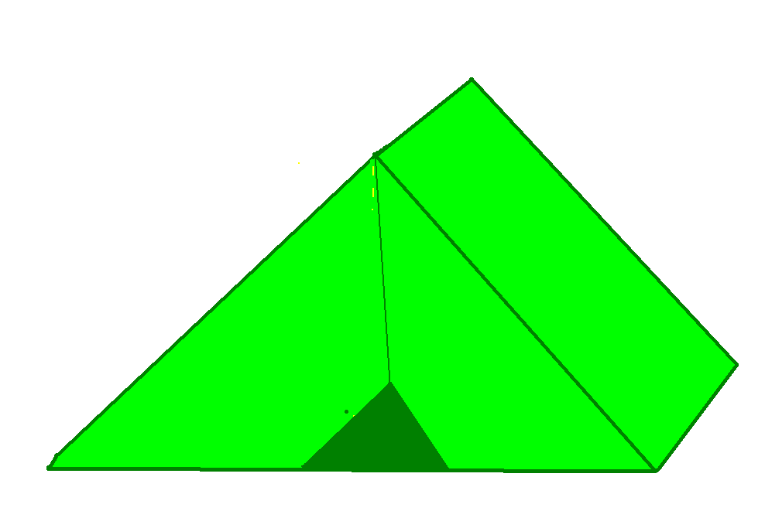
Once in a little tent in the middle of the desert a baby was born.
We will call him
Mohamed
Unfortunately the baby had no father, just a mother. No one could provide for him.

Slide 4
At this year there were many signs of the prophet. The falling of 14 towers of the palace of the Khusraw of Iran fell down, The great fire which had been burning for 1000 years was distinguished, but none were as noticeable as the attack issued on the kabba…

Slide 5
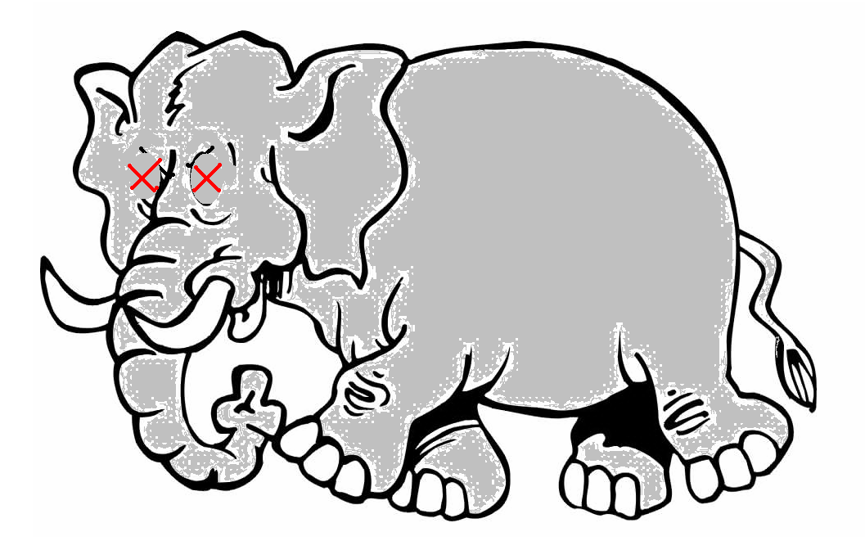
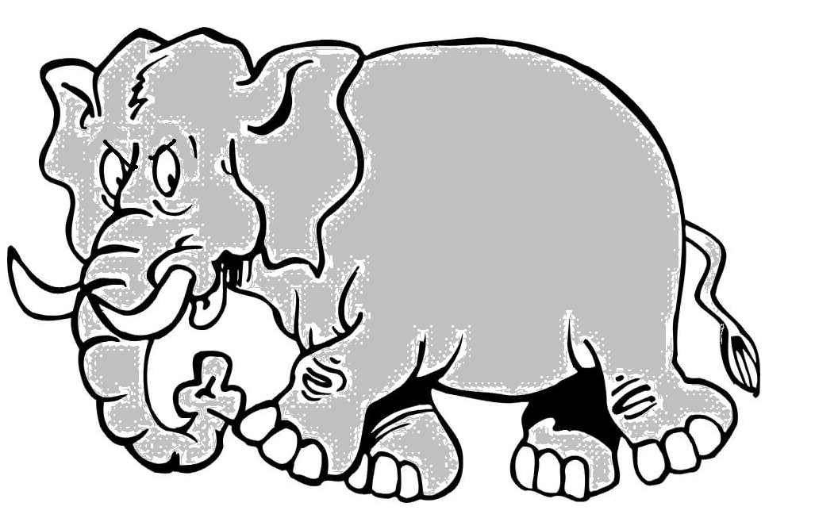
But Allah protected the Kaba by sending birds with rocks from hell.
When Allah did this all he was protecting was a house of kuffar worship surrounded by 365 idols! Why would he protect this??? The answer lays in the future…

Slide 6
Sirat Of The PROPET (SAW)
LIFE IN MAKKAH
PART 2

Slide 7
KEY
Halima
Abu-Mutalib
Abu-talib
Mohamed (S)

Slide 8
Early Childhood
Rasulullah (SAW) belonged to the tribe of Qurish and a family called Banu Hashim, His mother is Aminah, and his father was Abdullah.

Slide 9
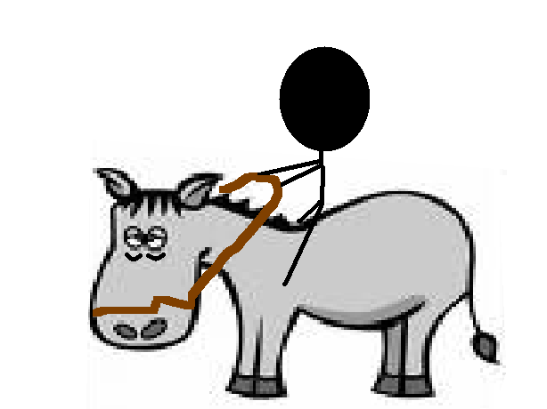
One of the great traditions of the Arabs was to send them to foster homes, were they grow up in tough conditions, and return to their families with gratefulness. All the caretakers came into town, took all of the babies from the richest families than left. Unfortunately Mohamed was very poor so nobody could adopt him then hope arrived…Just not in its best form.

Slide 10
Arriving on a old donkey, she tended to be later than the others. She herself was weak, she had no milk to feed her infant, her camel was to skinny for travel, and her donkey was old. Her name was Halimah.
Then she came upon Mohamed’s Grandfather, Abd Al-Mutalib!
ٍSir can I please adopt your son??
Oh please
Do!!!

Slide 11
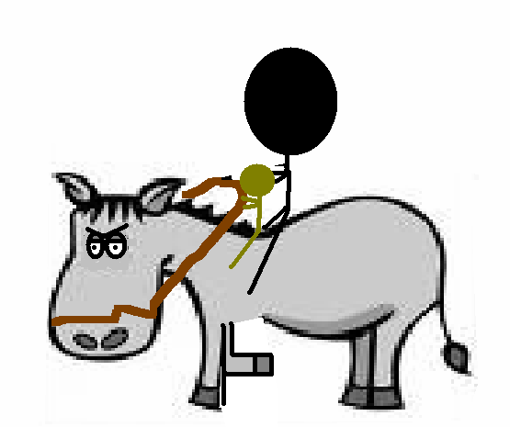
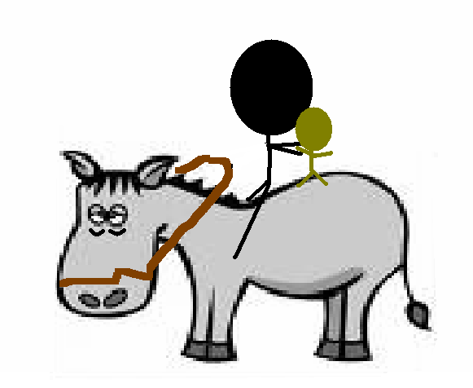
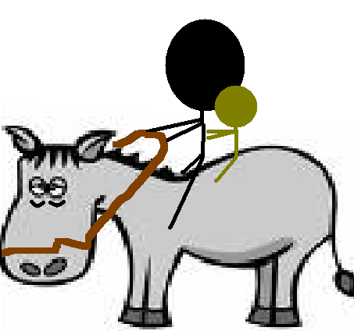
Halimah was facing problems! The new born son was putting weight on the donkey.
Put him on the front of your donkey.

Slide 12
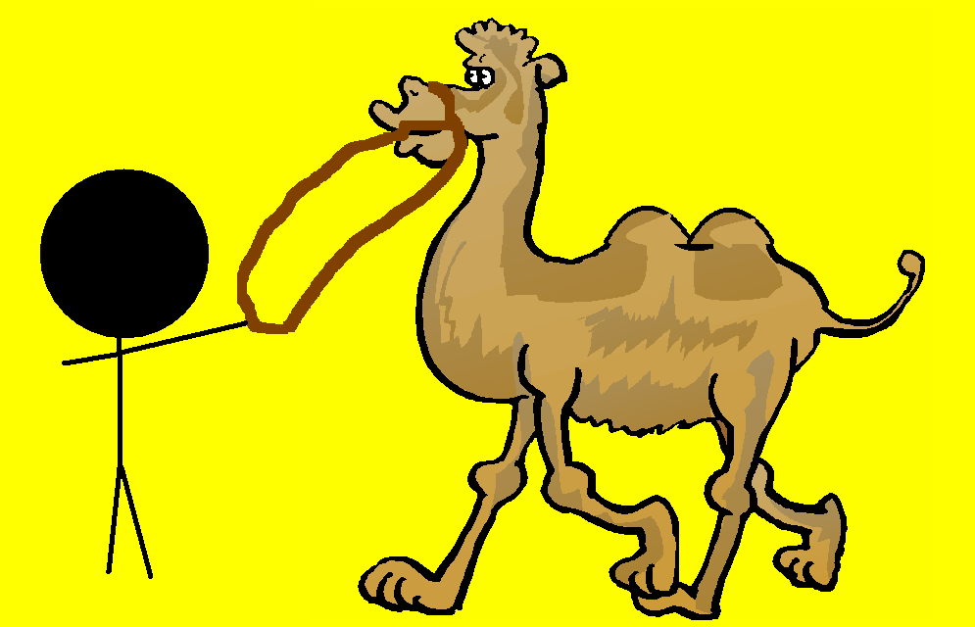
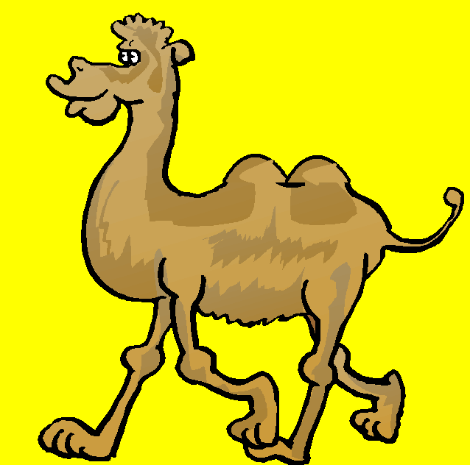
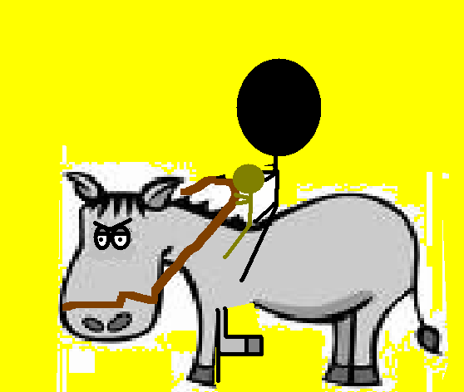
Then with a quick jolt of energy the donkey blasted away!!! Passing the others who had arrived earlier than her.
WAIT FOR US!!!

Slide 13
When they arrived at the camp blessings happened… the rain finally fell, the camel produced milk by the gallons!!! EVERYONE loved the new baby!

Slide 14
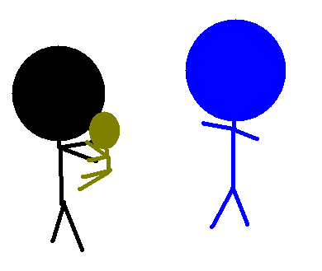
2 years passed and Mohamed is finally 4 years old! Halima would like to keep Mohamed but sadly she must return him to his family. Luckily she convinced them to keep him for a little more time.

Slide 15
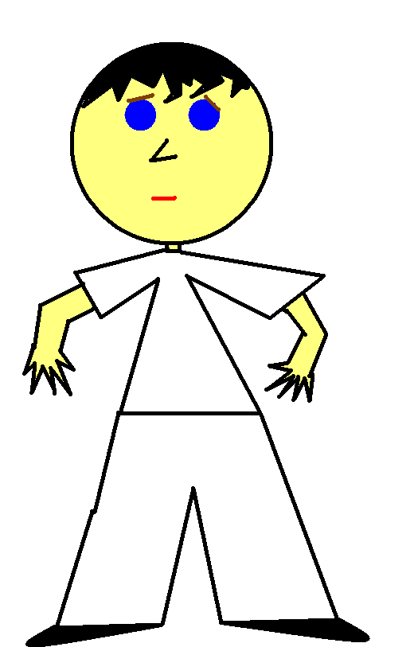
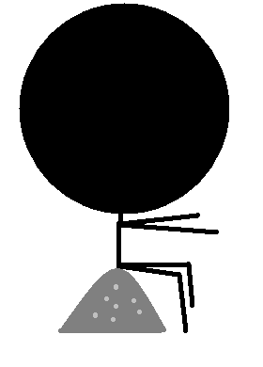
Then an extraordinary event happened! 2 Angels disquised as men in white clothes came to the prophet, opened his chest, then cleaned his heart with nour (light).

Slide 16
Many of the little kids were shocked and ran home as fast as they can to there moms to tell about the event…the news spread at great speed. Everyone rushed to the prophet to find him sitting on the desert sand…scared.
You had us all so worried!
Mohamed are you okay?!?

Slide 17
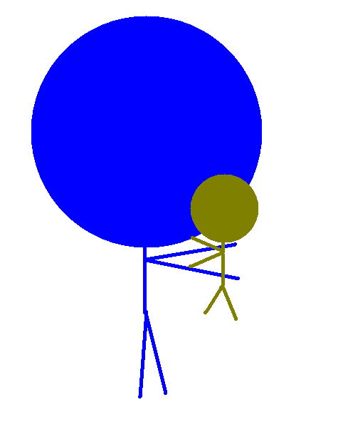
At the age of four (due to this event) the prophet returned to this mother. The family was delighted to have their baby back…

Slide 18
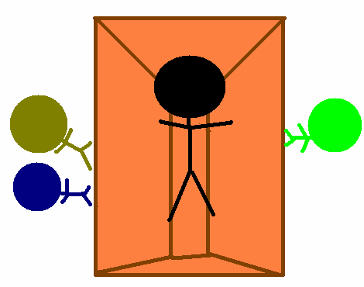
At the age of 6 Aminah and Mohamed went to visit the grave of his long lost father not to far from Makkah, then Aminah got very sick… she died a few days after reaching Makkah. Then she was put in her grave as the family members helplessly watched. His own mother died as a kafir.

Slide 19
Sirat Of The PROPET (SAW)
LIFE IN MAKKAH
PART 3

Slide 20
KEY
Halima
Buhaira
Abu-Mutalib
Abu-talib
Mohamed (S)
Khadijah(R)

Slide 21
At the age of 6 Aminah and Mohamed went to visit the grave of his long lost father not to far from Makkah, then Aminah got very sick… she died a few days after reaching Makkah. Then she was put in her grave as the family members helplessly watched. His own mother died as a kafir.

Slide 22
The prophet is now a complete orphan. He had none of his parents left. NOW who will take care of him. The first one to take him into his own hands was the one who named his the unique name Mohamed…his grandfather, Abu-mutalib!
After 2 years his grand father died. His uncle took care of him.

Slide 23
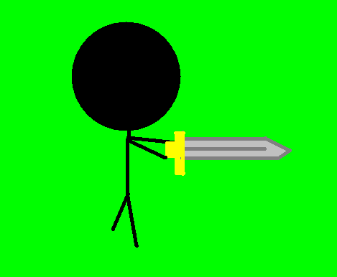
Mohammad (S) the peace maker
It wasn’t unusual that Arab tribes would fight with each other…even over small maters. They fought over every thing like barbaric savages! The prophet was a young man when the war of Fijar went on. During this was the tribe of Qurysh and the tribe of Qais were fighting. They then made a treaty which made the prophet happy…even years later and he still stated, “I still accept this treaty. It’s more dear to me than the most valuable things in the world!”

Slide 24
A big argument settled
The Kabba was under construction…The final stone was about to put in place…the black stone. Everyone wanted to put it in. The prophet solved this problem by bringing a piece of cloth and put the stone in the middle. Then he asked everyone from a tribe to pick up a corner of the cloth. They carried it up together than put it in.

Slide 25
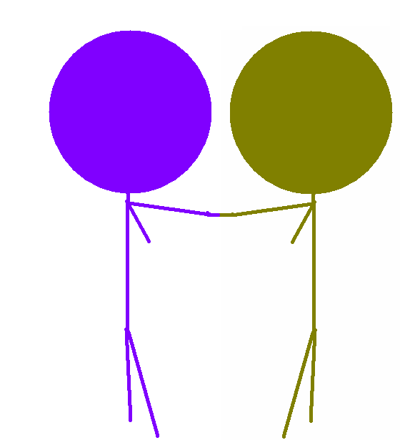
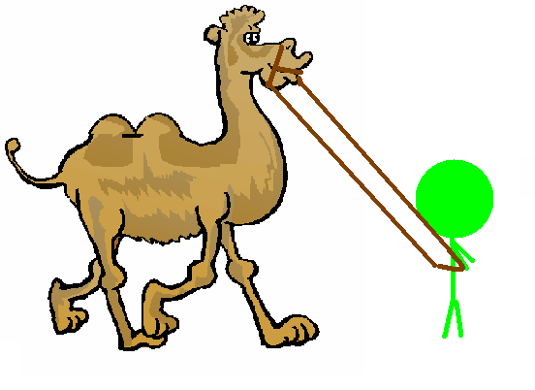
Your nephew will be a great leader and a prophet, protect him from his enemies!”
No you are not. This young man is an orphan!
Are you the father of this man?
Z
Z
Z
How did u know?!?
YES
One time Abu-talib took Muhammad on one of his merchanting trips. It was a hot day when a Christian monk named Buhaira saw one cloud in the sky…following a caravan. He suspiciously inspected the caravan and saw the prophet.
Buhaira longed to see the prophet again. He invited the caravan to dinner. At first the prophet didn’t attend, this caused him to worry. Then the prophet came!!! He greeted the prophet and later he found a birthmark… the seal of the prophet.
Later he saw the prophet sleeping under a tree prophet Noah once sat under. The leafs snuggled around him as if it were a blanket.

Slide 26
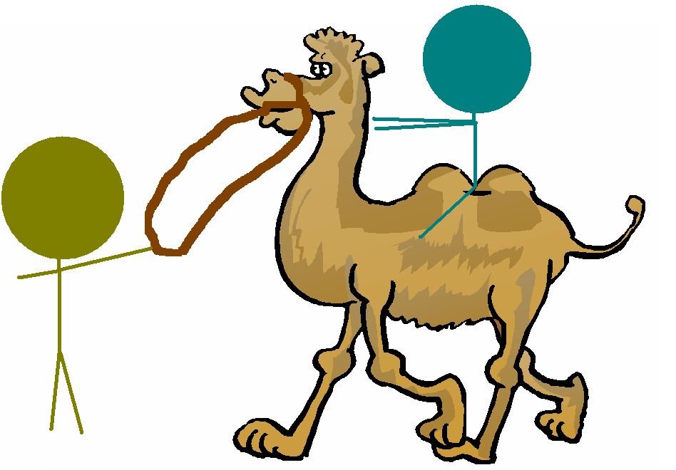
Events leading to Marriage
A wealthy widow named Khadija lived in makkah. She had only heard of the prophets kindness and how he was called asadiq alameen when she once trusted Muhammad (s) with a caravan of goods to be sent to Medina in exchange she would give him double share in the prophets… Muhammad (s) agreed.
Just to make sure, Khadija also sent a slave with him. Although nobody treaty slaves nicely, Muhammad (s) treated Maisarah as if he was his own brother!!! After this Maisarah reported to Khadija…
They KNOW he is honest
And NEVER cheats
Muhammad makes good prophets because people trust him

Slide 27
MARRIAGE
They lived happily for 25 years, seven children were born to them. Their 3 sons died but their 4 daughters lived. There was an age difference… Muhammad was 25 and Khadija was 40

Slide 28
Sirat Of The PROPET (SAW)
LIFE IN MAKKAH
Part 4

Slide 29
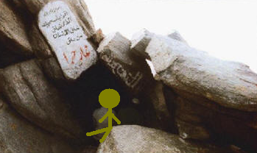
Mohamed (S) realizes evil
Mohamed (S) took a look at the world around him. He first freed the slave that Khadija gave him, his name was Zaid. Then he treated him as he were his own son. At the time people believed in many gods and they were all made of stone!! Mohamed (S) didn’t like this. He slowly lost interest in business and gave away lots of wealth and freed tons of slaves! Then he settled in cave Hira for a period of time and thought deep thoughts…

Slide 30
Mohamed a prophet!?!
THIS IS MOHAMED’S VEIW IN CAVE HIRA
Its beautiful today
There must be some
reason…
Why are we here?
Do you need
anything
Else???
HERE IS ALL YOUR FOOD
MOHAMED
Thank you khadija
NoThank you…

Slide 31
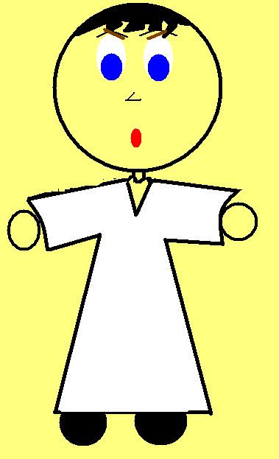
Mohamed woke up with a far away bright light
Then the man squeezed Mohamed (S) in a very tight manner…he felt as if he were to faint
READ!!!
READ!!!
WHAT?!?
I don’t know how
I don’t know how
I don’t know how

Slide 32
ٱقْرَأْ بِٱسْمِ رَبِّكَ ٱلَّذِي خَلَقَ
عَلَّمَ ٱلإِنسَانَ مَا لَمْ يَعْلَمْ
ٱقْرَأْ وَرَبُّكَ ٱلأَكْرَمُ
ٱلَّذِى عَلَّمَ بِٱلْقَلَمِ
خَلَقَ ٱلإِنسَانَ مِنْ عَلَقٍ
Read in the name of your lord
The one who made u from a blood clot
Read for your lord is the most generous.
The one who taught with the pen
He taught what man did not know

Slide 33
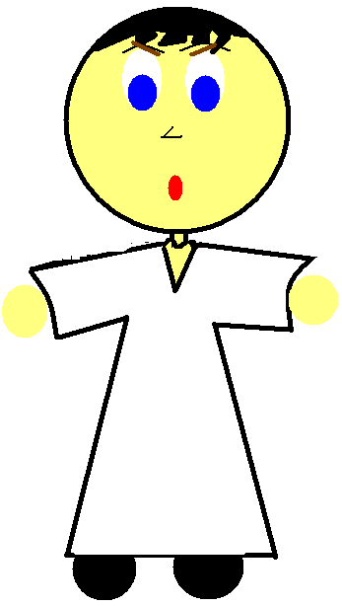
Then the man disappeared in thin air. When Mohammad (S) saw this he was confused. He had no idea what was happing! He did not know that these were spoken to him from Allah (S)

Slide 34
READ

Slide 35
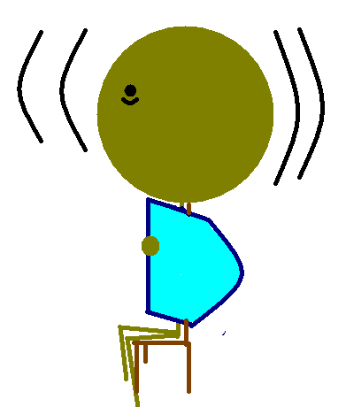
After the prophet regained his strength he muttered all that happened.
Mohamed are u okay??
Can you wrap me
With a blanket?

Slide 36
The next day khadija took Muhammad to her cousin.
Every prophet who came to deliver a message
Never had a good time doing so and being at ease.
Some people will try at their most extreme devotion and will
deny the message
Perhaps the same angle who came to the other prophets
had came to you! Perhaps you are the great prophet
Allah promised. If this is true, your own friends will haunt you,
and members of your own tribe will turn against you.
Why would they persecute ME?

Slide 37
The prophet didn’t start spreading the message right away. He was still a bit terrified from the impact of the first wahi. He was still shaky and confused and wrapped himself in blankets. Then Allah(SWT) reviled the second wahi.
Al-Muddaththir In the name of Allah, the Beneficent, the Merciful
سُوۡرَةُ المدَّثِّر بِسۡمِ ٱللهِ ٱلرَّحۡمَـٰنِ ٱلرَّحِيمِ
O thou enveloped in thy cloak, (1)
يَـٰٓأَيُّہَا ٱلۡمُدَّثِّرُ (﻿١﻿)
Arise and warn! (2)
قُمۡ فَأَنذِرۡ (﻿٢﻿)
Thy Lord magnify, (3)
وَرَبَّكَ فَكَبِّرۡ (﻿٣﻿)
Thy raiment purify, (4)
وَثِيَابَكَ فَطَهِّرۡ (﻿٤﻿)
Pollution shun! (5)
وَٱلرُّجۡزَ فَٱهۡجُرۡ (﻿٥﻿)

Slide 38
Wahi
☺Wahi is an arabic word that means revelation. The Quran is considered to be a Wahi from Allah (SWT)☺.
<== CLICK TO GO BACK

Slide 39
Sirat Of The PROPET (SAW)
LIFE IN MAKKAH

Slide 40
Key
Abu-talib
Any slave
Khadijah(R)
Ali (R)
Abu Bakr (R)

Slide 41
Secret Stages
go to KEY
If Muhammad (S) would go to the public and say that he is a prophet then he would of probably been killed. So Allah commanded him to go through secret stages. These would go on until Allah gave him permission to speak publicly (which turn out to be 3 years later).
He started out with the most trusted, secretive people. First his wife, then Ali (his cousin) then Abu Bakr (his best friend), after that Zaid…these came to be the first sahabahs of Islam.
You have always been the most truthful cousin, I believe you
You are my closest friend, I believe you
You are a kind master, you made me a free man…I believe you.
I know how truthful you are…I believe you

Slide 42
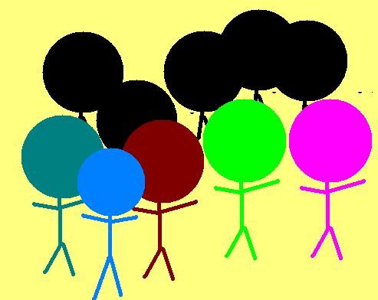
Then I will warn you of something more
Important!!!
I am the messenger of Allah(SWT) to you
I swear by Allah(SWT) you will die
Similar to the way you sleep. And
You will wake up from death similar
To the way you wake up from sleep.
And it is going to be either an everlasting
Paradise or an everlasting hellfire.
Your idols are not GODS!!! They have
No mind!!! They can’t do anything for
Themselves!!! You are even the ones who
Made them!!! Allah is the only god,
You’ll turn to him when you die!!!
You must must fear the Day of Judgment!!!
On that day nothing can save you except your
Belief from him and your good deeds
If I said that there is an army behind
This hill waiting to attack us, would
You believe me?
Yes, you are
Asadiq alameen-
“YOU ARE A WASTE OF OUR TIME!”
You are possessed by
spirits!
Your insane!!!
When The Prophet said this all the makkans got angry! They shouted at him and mocked him in a very disrespectful manner… but worst of all was abu-Lahab. For he was one of The Prophet’s uncles! As wariqa predicted, they became his enemies. And due to the insults of Abu Lahab Allah (SWT) made a whole sura inside the quran, Surat Al-Masd (111:1-5)
The 3 years of secret dawa passed, Allah (SWT) finally gave orders to spread the message. Muhammad approached them in a very unique way. He called everyone in town to a meeting then stood above a hill where everyone could see him.

Slide 43
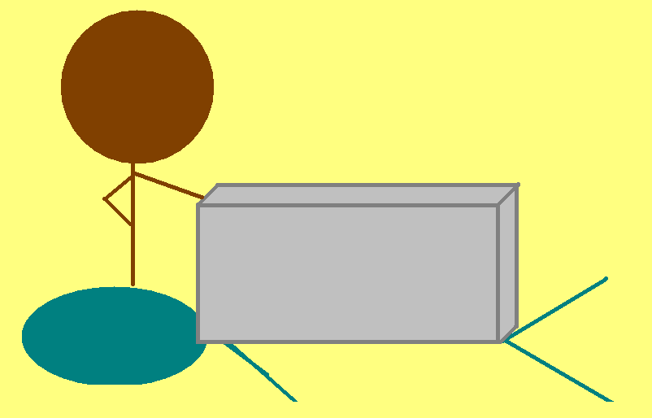
The believers
Most of the people who believed in The Prophet were either poor, weak, helpless with no tribe or family to defend them, and widows! They were persecuted by the masses! Tortured to give up Islam. but the first ones who accepted is Islam are the true winners!!! And the one who died among the early stages of islam are among the first suhuda. For example one of the punishments was to lay him on the hot sand and put a heavy rock over them. One of the Muslim’s names were Ballal. He was a slave and didn’t have a clan to protect him so he was punished not to pray and when he was tortured he would always say to torment the Kuffar “ahadun, ahd” twice!!! The literal meaning of this is “one, one”. But he meant that there was only 1 god, Allah (SWT)
One, one

Slide 44
Sirat Of The PROPET (SAW)
LIFE IN MAKKAH
Part 6

Slide 45
The Prophet and his neighbor
Serves you right!
An example of the patients and kindness he endured was with is neighbor in Madinah. His neighbor was a jew who would every day dump trash in the door way of The Prophet (SAW).
One day there wasn’t and trash. The Prophet was concerned and went to the neighbor’s house to visit him and see if everything was okay.

Slide 46
When I woke up this
Morning I realized
That there isn’t any trash
On my door step so
I know there is something
wrong
Why are you here?!?
For the rest of the day The Prophet (SAW) sat by the sick person and was kind to him despite that everyday the Jew would dump a load of trash on The Prophets (SAW) door step. When the Jew became better he accepted Islam, and the Jew was no longer a Jew.
When The Prophet went to visit him the Jew was sick. The Jew was alarmed and confused as the Muhammad (SAW) came in.

Slide 47
The miracle of the Quran
Arabs were proud of there language. There were always poets bragging about their most beautiful piece of poetry! When the Quran came down the poets were always trying to always trying to prove that they were able to make better poetry than the words of Allah. So Allah reveled to The Prophet in Surat Al-Isra’.
قُل لَّٮِٕنِ ٱجۡتَمَعَتِ ٱلۡإِنسُ وَٱلۡجِنُّ عَلَىٰٓ أَن يَأۡتُواْ بِمِثۡلِ هَـٰذَا ٱلۡقُرۡءَان
ِ لَا يَأۡتُونَ بِمِثۡلِهِۦ وَلَوۡ كَانَ بَعۡضُہُمۡ لِبَعۡضٍ۬ ظَهِيرً۬ا (﻿٨٨﻿)
Al-Isra
Say: Verily, though mankind and the jinn should assemble
to produce the like of this Qur'an, they could not produce
the like thereof though they were helpers one of another.
(88)

Slide 48
The miracle of the Quran
Then when they realized that these words in the Quran cannot be beaten they decided to go with a new path. They would spread the classic rumors about Muhammad (S) the same way the people before them would spread rumors of the previous prophets like, he is a musician, and he is possessed by sprits. Allah (SWT) then criticized these rumors in surat al-Qalam.
سُوۡرَةُ القَلَم
مَآ أَنتَ بِنِعۡمَةِ رَبِّكَ بِمَجۡنُونٍ۬ (﻿٢﻿) وَإِنَّ لَكَ لَأَجۡرًا غَيۡرَ مَمۡنُونٍ۬ (﻿٣﻿)
وَإِنَّكَ لَعَلَىٰ خُلُقٍ عَظِيمٍ۬ (﻿٤﻿) فَسَتُبۡصِرُ وَيُبۡصِرُونَ (﻿٥﻿) بِأَييِّكُمُ ٱلۡمَفۡتُونُ (﻿٦﻿)
Al-Qalam
Thou art not, for thy Lord's favour unto thee, a madman(2)
And lo! thine verily will be a reward unfailing(3)
And lo! thou art of a tremendous nature(4)
And thou wilt see and they will see(5) Which of you is the demented. (6)

Slide 49
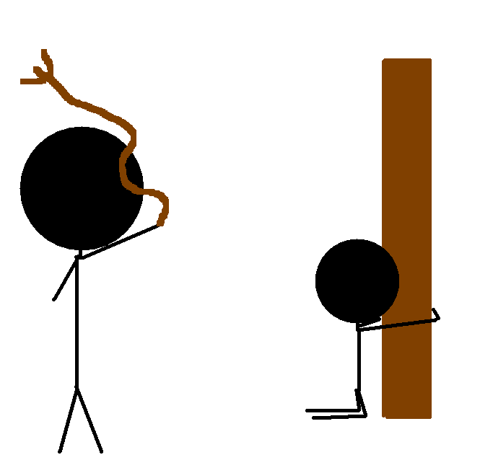
Abu Thur Al-Ghifari
Abu Dharr Ghiffari(R) was a person who belonged to the Ghiffari Tribe. His tribe was a great enemy to The Prophet. He heard of The Prophet and got curious of this man so he went to meet him secretly to avoid harm. He heard the Quran and its beautiful, poetic tone, and heard the message of islam then he became a Muslim. The Kuffar were enraged of this foreigner and beat him mercilessly. But he didn’t give up his religion he, like Bilal, tormented the Kuffar by saying, “Allah is one, Allah is one!”
Allah is one.

Slide 50
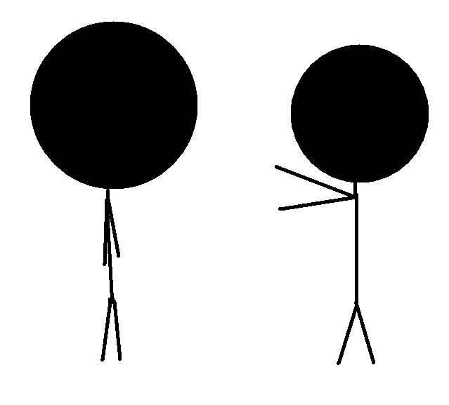
Al-Walid Ibn Almugeera
Are you the new Prophet
Of god?
Walid, have you heard
Of the man who claims
That he is a prophet?
Tell me of your religion
He says that our
Gods are fake and
There is only
1 true god.
Yes I am.
What!!
I will go visit him
And see if what
He says is true.
No.
So The Prophet told the poet of the message of Allah (SWT) and recited a bit of the quran. The poet was shocked and stunned by this poetry! He knew these words were not the words of a man. He came back to his people stunned
There was a poet by the name of Al-Walid Ibn Almugeera, he was famous for his great poetry. He heard of The Prophet (S) like many other people and decided to go visit him.

Slide 51
Allah (SWT) said EXACTLY how the poet acted in this situation in surat Al-Mudathir. When the poet returned to his people stunned.
Walid, you have returned!
How did that meeting
With that phony
“prophet”go?!?
18-
19-
20-
This is nothing but
A ordinary man’s words
This isn’t anything
But a known magic trick!
21-
22-
23-
24-
*Scratch*
25-
*Scratch*
إِنَّهُ ۥ فَكَّرَ وَقَدَّرَ (﻿١٨﻿)
فَقُتِلَ كَيۡفَ قَدَّرَ (﻿١٩﻿)
ثُمَّ نَظَرَ (﻿٢١﻿)
ثُمَّ أَدۡبَرَ وَٱسۡتَكۡبَرَ (﻿٢٣﻿)
فَقَالَ إِنۡ هَـٰذَآ إِلَّا سِحۡرٌ۬ يُؤۡثَرُ (﻿٢٤﻿)
إِنۡ هَـٰذَآ إِلَّا قَوۡلُ ٱلۡبَشَرِ (﻿٢٥﻿)
ثُمَّ قُتِلَ كَيۡفَ قَدَّرَ (﻿٢٠﻿)
ثُمَّ عَبَسَ وَبَسَرَ (﻿٢٢﻿)
This is naught else than speech of mortal man. (25)
(Self-)destroyed is he, how he planned! (19)
Then looked he, (21)
For lo! he did consider; then he planned - (18)
And said: This is naught else than magic from of old; (24)
Again (self-)destroyed is he, how he planned! - (20)
Then frowned he and showed displeasure. (22)
Then turned he away in pride (23)
Then he looked at his people.
When Allah (SWT) repeats himself then he is trying to make a huge point. Here he is saying that indeed he has doomed himself. When he rejects the message of Allah(SWT) from The Prophet (SAW) himself!
Remebering who he has and how people veiwed him in society he became ignorant. He remembered that he was the greatest poet in all of Makkah. He turned away from the message of Allah (SWT)
Then he said that this is nothing but an old, well known magic trick! He claimed that Muhammad (S) was nothing but a musician.
He said that these words have no significance to them. These words aren’t great, they are just any words from a man.

Slide 52
Sirat Of The PROPET (SAW)
BY: Shadow of Anonymous
Part 7
LIFE IN MAKKAH

Slide 53
The First Hijrah
Bilal (R) and Abu Dharr Ghiffari (R) weren’t the only people who were being abused. There were Yassir (R), Summayyah (R) and son Ammar (R), Khabbab (R) and etc. The Muslim nation in general was being tortured and persecuted and being dragged down the streets by their necks, and yet these loyal Muslims followed the orders of rasulluah (S) and didn’t fight back. Due to this the first Hijrah was started. The prophet told a party of 11 men and 5 women migrated to Abyssinya with Jafar (R) as their representitive. People left their wife, children, and wealth behind to go to the Christian kingdom of Abysinna (in Ethiopia). The kuffar told the king Nanjashi to hand the Muslims over but he refused. The king and his nation were from the Ahl Al-Kitab. When the king talked to a Muslim man by the name of Jafar (R)…
One, one
Allah is one.

Slide 54
Hijrah
☺Hijrah is an arabic word refering to a migration from one place to another. Throughout the prophet’s lifespan there were two major Hijrahs. The first is to Abysinya, and the second is to Madinah☺
<== CLICK TO GO BACK

Slide 55
Ahl Al-kitab
☺Ahl Al-kitab is an arabic word that literally means “the people of the book”. But the word more commonly refers to the Jews, and the Christians. ☺
<== CLICK TO GO BACK

Slide 56
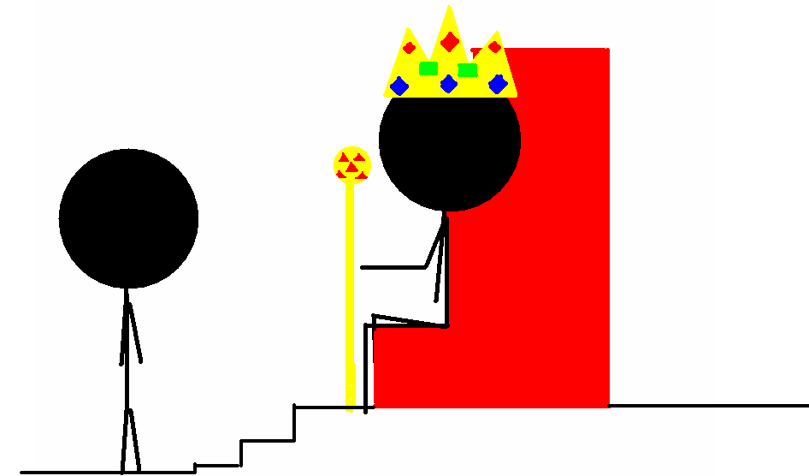
The king was impressed by this man’s speech. Then Jafar (R) recited some verses from Surah Maryam 19:1-36. About the birth of Yahya (A) and Isa (R). The king was moved and made up his mind not to surrender the Muslims to the kuffar.
We walked in the darkness of evil and
did not know the right path. We worshipped idols of stone
And led unclean lives. We had no respect for human beings, neighbors,
Or guests. We used to kill and steal. Allah has been kind to us
And sent his prophet.
We know the prophet very well, he is kind,
truthful, trust worthy, and pious. He invited us to Islam. He taught us
Tawhid the worship of Allah alone. He teaches us to speak the truth
and to keep our trust, to respect the rights of our women and orphans, the
Poor, and our neighbors. We believed in Muhammed (S) as a prophet.
We are Muslims. Because of the acceptance of the truth of Islam our
Own people have become our enemies. They persecuted us in Makkah
and now they have followed us here!
They want to kill us because our faith!

Slide 57
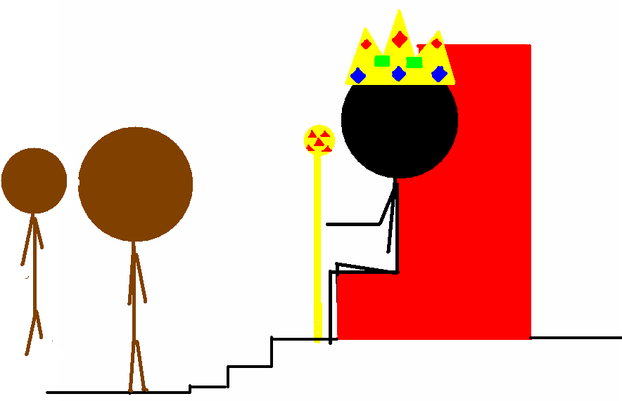
The Muslims don’t
Believe in the divinity
Of Jesus and have very different ideas about
the Christian doctrines.
The kuffar became angry! They couldn’t believe the fact that the Muslims have ran away and the king refused to give them back! So they devised a plan. They were aware of the Muslim beliefs about Isa (R) (Isa is Jesus in Arabic). They thought that they could use that against the Muslims! The next day the powerful leaders of Makkah came to King Najashi. And said…

Slide 58
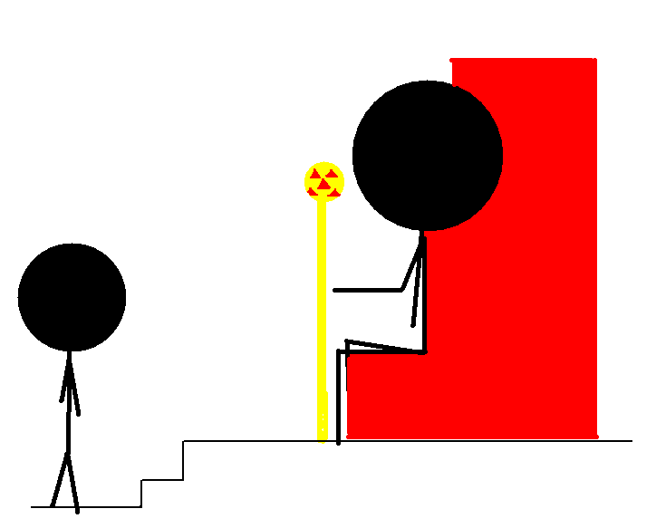
So the wise king analyzed the Muslims. They were a lot different than the Makkans. They were more polite friendly and less savage. Slowly the king became convinced that Islam is nothing but the truth, and he himself became Muslim.
The king being just and fair didn’t kick them out right then. He called Jafar and the other people to come again. So the king told them what happened and asked if this was true. And the Muslims said…
The Muslims don’t believe in the divinity
of Jesus and have very different
ideas about the Christian doctrines.
Rasulullah has taught us that Jesus
is a servant of God.
His spirit and His word
breathed into virgin Mary.

Slide 59
Sirat Of The PROPET (SAW)
Part 8
LIFE IN MAKKAH

Slide 60
Hamzah (R)
Hey Muhammad,
#@$%#@!&*
What would
Hamzah say if he
Heard that?!?
2 years older than Muhammad (S) and a strong man was a man who went by the name of Hamzah (R). The prophet (S) was a his nephew, and was a good friend too, but Hamzah never put any thought into becoming a Muslim.
Once, Alhakam Ibn Amr Ibn Hisham (more commonly known as Abu Jahl), a great enemy of Islam, insulted the prophet (S). Like usual the prophet didn’t start any trouble and took the insult, and walked away. But one person heard this dirty insult. He was surprised that Muhammad (SAW) just walked away without saying anything. He told Hamzah (R) about this and Hamzah became furious. At this time, when someone insulted a person from your tribe, you were obligated (By society) to defend that person and your tribe.

Slide 61
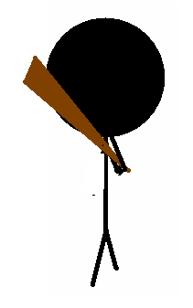
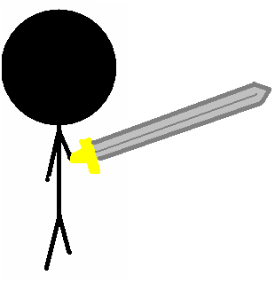
When Hamza heard the news, he made a special visit to Abu Jahl…
So then Hamza (R) went to the prophet and asked him about his religion. The prophet taught him about Islam and Hamza (R) became a believer! He was the first step for Islam becoming a super power.
When Hamza (R) injured Abu-Jahl, people from his tribe came over enraged, and a fight was about to start
And don’t insult Muhammad,
Or anyone from my tribe
Again!
No it is Okay, let Hamza
go

Slide 62
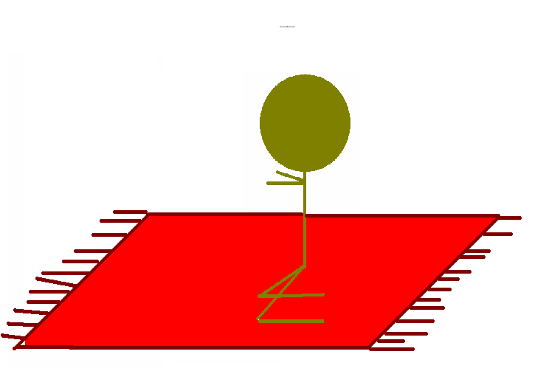
‘Umar (R)
Oh Allah, choose to Islam the
One you love more…’Umar (R)
Or Alhakam Ibn Amr Ibn Hisham
(Abu-Jahl)
In the same week that Hamza (R) became Muslim the prophet Muhammad (SAW) prayed to Allah…

Slide 63
I’m going to kill Muhammad!
That witch who divided our
Clan and caused trouble!
WHAT!
OMAR!!! Where are you
Going?
Before you start cleaning
Other people’s houses
Then take care of your’s
First! You Sister is a
MUSLIM!!!
So Omar (R) was a strong man, like Hamza (R), and hated Islam. Although nobody dared to kill Muhammad (SAW), Omar set out to finish Islam once and for all with his sword. But on the way he met a man…

Slide 64
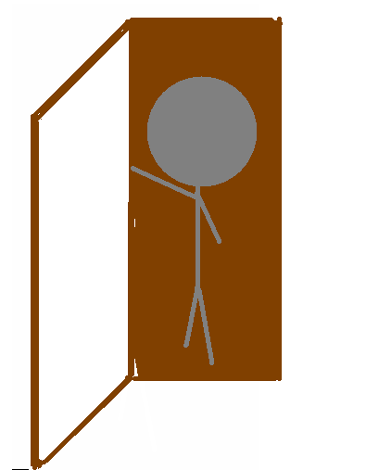
So his sister, his brother in law, and a Shabah were all reciting Quran when ‘Umar fiercely knocked on the door! They all trembled in fear and hid the Sahabi!
HOW DARE YOU!
YOU ARE A DISGRACE
TO OUR TRIBE!
Oh no, this is the knock
Of ‘Umar!!!
You must hid
My friend!
*Knock*
*knock*

Slide 65
Sahabah
☺The word Sahabah is a word in the arabic language that means companions. But when this word is used in arabic it is understood that we are talking about the companions of the prophet.☺
If the word was singular it would be Sahabi
<== CLICK TO GO BACK

Slide 66
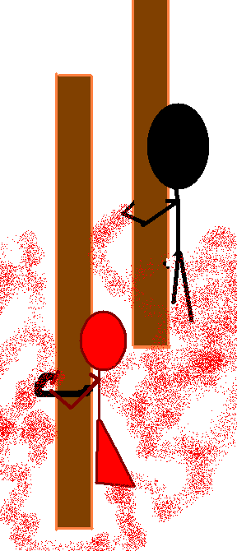
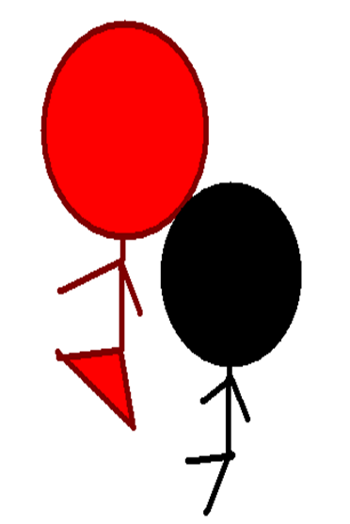
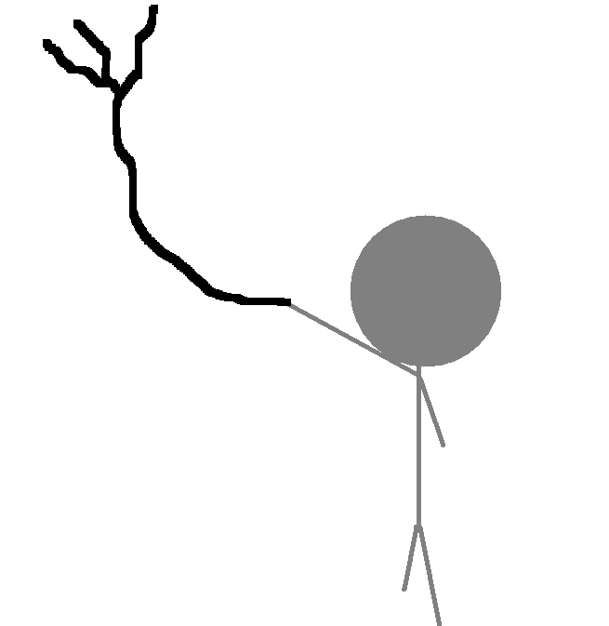
IT isn’t man made!!!
It is perfect and beautiful!!!
Ashad ana la illaha ila Allah
Washadu an Muhamed Abuhu wa
Rasulluh.
Congratulations Omar, I have heard
The prophet (SAW) prayed for
You.
Omar(R) then took them all outside, tied them up, and started whipping and beating them mercilessly! But even then his sister and his brother in law didn’t disbelieve. After a long time Omar got tired of beating and was astonished. Never has he seen such extreme devotion for a cause! So Omar (R) asked them to tell him about their religion.
After that Omar (R) finally got to learn about Islam. His brother in law read Surat Taha. It seemed so perfect and beautiful! Right when it said “Lo, I indeed, I alone am Allah, There is no god except me, so worship me” Omar cried…
Before they allowed him to touch the Quran, they told him to go clean himself

Slide 67
Ashad ana la illaha ila Allah,
Washadu an Muhammad Abuduhu wa
Rasulluh
☺ This is the Muslim way of accepting Islam and is refered to as the Shahada (not to be confused with Sahabah). This means, “I bear witness that there is no God but Allah, and I also bare witness that Muhammad (SAW) is his messenger. This is the first of the five pillars of Islam.
Sahadah
Prayer
Fasting
Giving Charity
Pilgrimage (around the Kahbah)
<== CLICK TO GO BACK

Slide 68
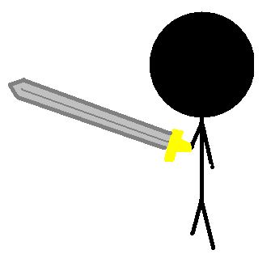
So Omar (R) with his sword came towards the house of the prophet. The Sahaba were terrified and pulled out there sword in self-defense. Everyone was trembling and terrified, except the prophet (SAW)…
It is okay, let him in.
If he tries to kill me
So help me god I
Will kill him with his
own sword!

Slide 69
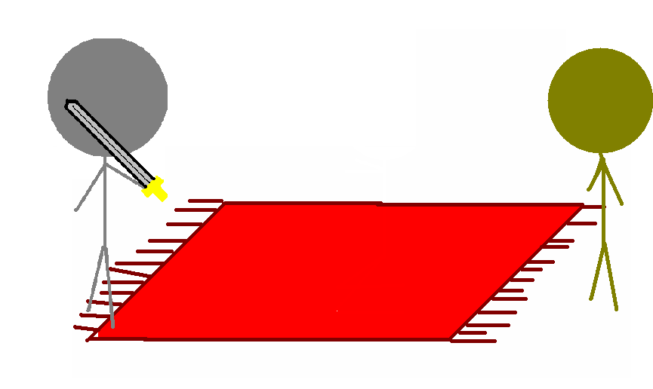
To accept Islam
Why are you here
Omar?
The prophet was pleased. With Hamza (R) and Omar (R) Muslims now felt more secure and walked toward the Kabah were the prayer for the first time was performed publicly. This is why Allah (SWT) kept a building with 365 idols!

Slide 70
Sirat Of The PROPET (SAW)
Part 7
LIFE IN MAKKAH

Slide 71
A CHEAP BRIBE
After this event of public prayer the kuffar became very frightened and nervous. Many kuffar thought Muhammed was challenging their fake gods for nothing but wealth, power, money, and women. They thought Muhammed had a quest for power so he wanted to act like a prophet! So they repeatedly threatened the prophet, but he wasn’t afraid because he knew that he was under Allah's protection. When that didn’t work they made an organized meeting: the conclusion was to bargain with the prophet (saw). A man named Utbah knocked onto the door the next day….

Slide 72
A cheap bribe
IF you put the sun in my
Right hand and the
Moon in my left…I
Would never quit preaching
The truth of Islam
Tell your nephew that if he
Wants power, we will give him power.
If he wants women, we will give him the best in Makah!
If he wants wealth, we will make him the richest of us all.
On one condition…he must stop preaching Islam!
The kuffar were furious and worried of Muhammed's (S) message. They were afraid that if Muhammed's message would spread, they will slowly but surely lose their wealth, respect, and power. So one day the kuffar desperately came to the door of Abu Talib, the uncle of the prophet (S).
Abu Talib took Utbah to the prophet. Abu Talib told the prophet of what happened, and the prophet replied without hesitation..

Slide 73
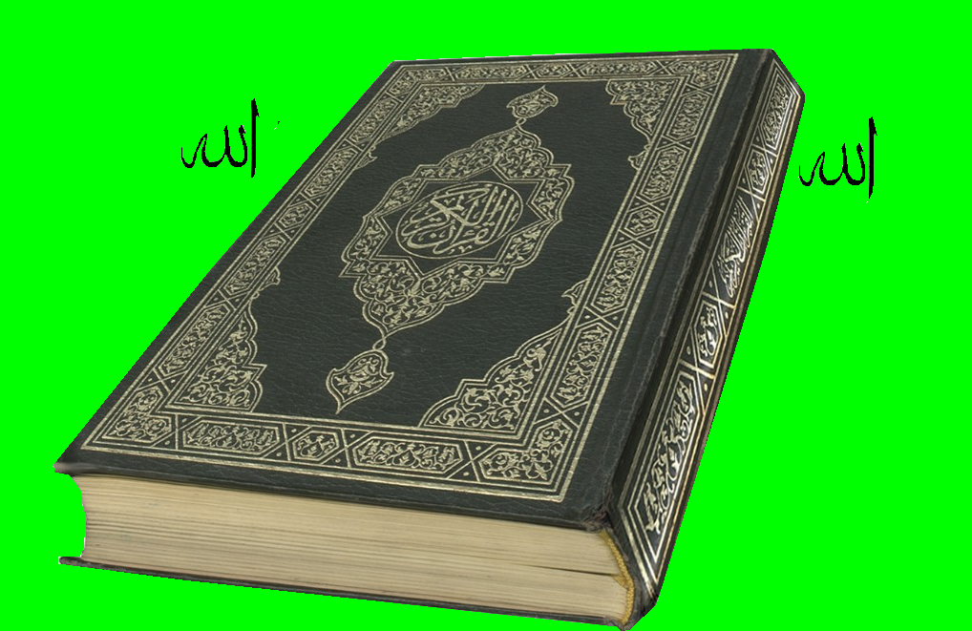
Allah then responded to this incident with a verse from the holy Koran…
قُلْ مَآ أَسْأَلُكُمْ عَلَيْهِ مِنْ أَجْرٍ إِلاَّ مَن شَآءَ أَن يَتَّخِذَ إِلَىٰ رَبِّهِ سَبِيلاً
Say I do not ask for any reward from you for my services. I’m just so that those who want to will follow a path to their lord. Alfurqan 25:57

Slide 74
And so Utbah returned to his people impressed, and he told the other non-believers.
I have heard things that
Never in my life have I
Ever heard such things…I advise you
To stay away from the
Prophet.
Mohamed’s magic must of
Affected Utbah as well…
What a shame.
Look, Utbah has returned!
So how did it go?
Well enough is enough!
from here on out we are
going to boycott Mohamed’s
tribe, Banu Hashim!

Slide 75
The Boycott and death
And the boycott started. All of Banu Hashim was affected by this massive boycott. But after 3 years they saw it was hopeless; the will of the Muslims and the love and devotion to the prophet was so great they were ready to die out of starvation. After these 3 years the boycott ended and many have died…including his beloved and supporting wife, Khadijah. And in the same week his uncle who would look out for him, and the uncle who protected him from his own tribe also died, Abu-Talib. With these two deaths the prophet was weaker than before. Khadijah supported the prophet with her wealth. And Abu-Talib would support the prophet because he was the leader of Banu-Hashim and without him Banu-Hashim could kill or kick Mohamed (SAW) out of the clan. Mohamed was sad but he still though, “the consumers died but the provider is still alive and will always be, Allah (SWT)!”

Slide 76
A lesson to be learned
What was the difference between Omar (R) and Utbah? Both knew that the Quran was true but why did one accept and one denied? The difference was that one made effort into accepting Islam ,and as for the other he knew it was true and yet he denied it. The same goes to the poet, Al-Walid Ibn Almugeera! In surat al-Bakra Allah says…
سُوۡرَةُ البَقَرَة
فِى قُلُوبِهِم مَّرَضٌ۬ فَزَادَهُمُ ٱللَّهُ مَرَضً۬ا‌ۖ وَلَهُمۡ عَذَابٌ أَلِيمُۢ بِمَا كَانُواْ يَكۡذِبُونَ (﻿١٠﻿)
Al-Baqara
In their hearts is a disease, and Allah increaseth their disease.
A painful doom is theirs because they lie. (10)
In this aya (verse), when Allah (SWT) says “disease” he means the disbelief in the message of Allah. So they already disbelieve in the message of Allah (SWT) and they persist on disbelief of Islam then Allah (SWT) punishes them by adding to their disbelief until they reach a point of no return and they become as ignorant as the pharaoh that prophet Musa (Moses) battled!

Slide 77
A lesson to be learned
There doesn’t only work in your disadvantage it also works in your advantage as well! There is a hadith that says, “To those who will take one step towards Me (Allah), I will advance to them in ten steps. ”What does this mean? For the goodness that you do, He will give you ten beauties, and you will grow very quickly in beauty and goodness.

Slide 78
Sirat Of The PROPET (SAW)
Part 10
LIFE IN MAKKAH

Slide 79
The Kuffars’ disbelief
To those who heard the language of the Quran in its most beautiful, and most poetic form there was not any excuse for them not to believe. All the poets had always showed talent during their early childhood, but Mohamed (SAW) got his revelation during adulthood and in its most beautiful form. It was hard to explain such a thing! At first, by natural instinct, they called him a poet. But Allah replied to this in surat Ya-sin when he said…
سُوۡرَةُ یسٓ
وَمَا عَلَّمۡنَـٰهُ ٱلشِّعۡرَ وَمَا يَنۢبَغِى لَهُ ۥۤ‌ۚ إِنۡ هُوَ إِلَّا ذِكۡرٌ۬ وَقُرۡءَانٌ۬ مُّبِينٌ۬ (﻿٦٩﻿)
Ya-Seen And We have not taught him (Muhammad) poetry, nor is it meet for him. This is naught else than a Reminder and a Lecture making plain, (69)

Slide 80
During the 10th-11th year of prophethood the kuffar continued to oppose Mohamed (SAW) in Makah and therefore he headed to Taif with Zaid (R).

Slide 81
TAIF
When he arrived he started preaching to the people of Taif. The quran says this…
وَمَآ أَرۡسَلۡنَا فِى قَرۡيَةٍ۬ مِّن نَّذِيرٍ إِلَّا قَالَ مُتۡرَفُوهَآ إِنَّا بِمَآ أُرۡسِلۡتُم بِهِۦ كَـٰفِرُونَ (﻿٣٤﻿)
وَقَالُواْ نَحۡنُ أَڪۡثَرُ أَمۡوَٲلاً۬ وَأَوۡلَـٰدً۬ا وَمَا نَحۡنُ بِمُعَذَّبِينَ (﻿٣٥﻿)
Saba And We sent not unto any township a warner, but its pampered ones declared: Lo! we are disbelievers in that which ye bring unto. (34) And they say: We are more (than you) in wealth and children. We are not the punished! (35)

Slide 82
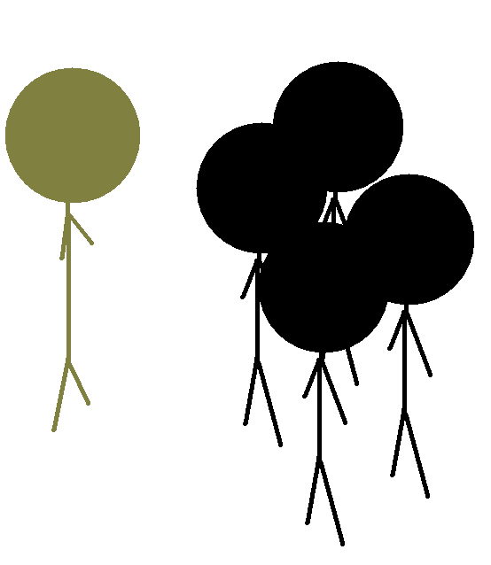
Believe into Allah (SWT) or
You will suffer the punishment
Of Hell!
We shall not believe in the revelation
which you bring!
We have plenty of wealth and
lots of children we shall not be punished

Slide 84
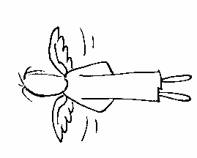
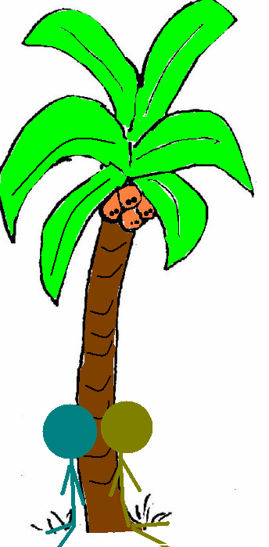
And outside the city of Taif he rested in a garden near a vine yard and his shoes filled with blood he prayed to Allah (SWT).
And then Allah (SWT) sent an angel to the prophet
If you wish Allah (SWT) will unite the
Mountains on both sides of Taif and
Crush the people between them
O, Allah to you alone I make complaint
Of my helplessness, lack of resources,
And insignificance before other men.
You are most merciful. The lord
of the helpless and you are my lord
In whose hands would You abandon me—
Of an unsympathetic enemy and an unkind
Foe? But if You are not angry with me
I don’t worry about anything else.
I seek protection in the light of Your
Face. You alone control all affairs
of this and the here after. And there is no power
Except Your power.
No! I don’t want any punishment for them.
I hopeAllah will guide them and their
children to the straight path.
And the prophet’s prayer became true. The children of the city later became Muslim 10 years later!

Slide 85
Then the owner ,Addas, came and saw them. The Arabs used to believe in the principle of hospitality so the owner came with a basket of grapes!
The conversation between them continued. After a while he accepted Islam, and tended the prophet’s and Zaid’s wounds.
These words are not generally
spoken by people here.
I am a Christian from Nineveh.?
Thank you…
In the name of
Allah most merciful
Most gracious.
Oh you are from the city
of my brother Yunus (A),
The prophet of Allah.
Where are you
From?

Slide 86
Addas’ master learned of this and he became furious! He called upon Addas…
How can you tend
To Mohamed without
My permission?!?
Yes master?
No one living on earth today is
better than this prophet.
He told me truth of which
Only a prophet can tell!!!
ADDAS!!!

Slide 87
Sirat Of The PROPET (SAW)
Part 11
LIFE IN MAKKAH

Slide 88
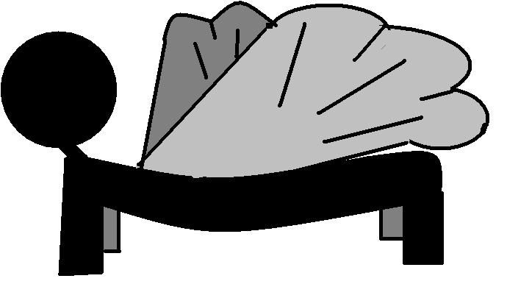
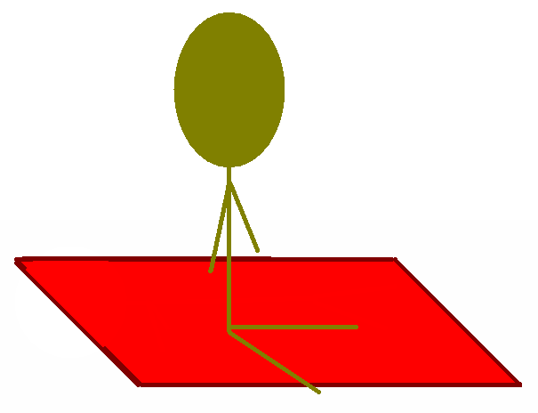
Isra’ And Miraj 12th year of prophet hood
One night Allah Decided to honor his last prophet. So he decided to send Jibreel (A)! He brought a strange animal by the name of “Buraq”. In Arabic buraq means lightning.
Mohamed!!!
Get on!!!
What?!?
Z
Z
Z

Slide 89
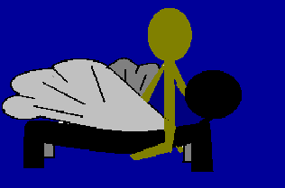

Slide 90
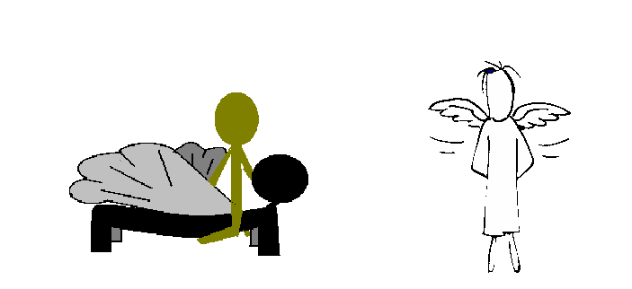
First he went to the Kahbah in a fraction of a second! There his heart was once again cleaned with the water of Zamzam and filled with noar (light).

Slide 92
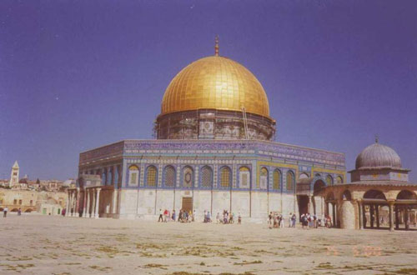
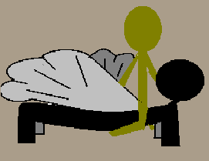
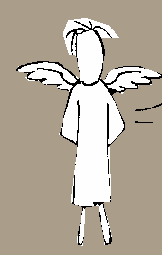
Then he arrived to Jerusalem where he lead the prayer with all the Prophets and Messengers of Allah (SWT). The place is now know as The Dome of Rock.

Slide 93
Then they ascended to Heaven…

Slide 94
First the prophet went through hell. He saw all kinds of punishments.
First he saw a man with claws ripping out his flesh…
He is the one
Who would constantly
Delay the prayers!
Who is that?!?

Slide 95
Then there was a man who would swim around in a lake of blood. Then after every lap he made he would return to the shore and eat a rock.
That is the man
Who would be involved in
interest
Who is that?
*munch*

Slide 96
Then he saw men and women baking in an oven…
Those are those who
Committed adultery.
And had boyfriends
Or girlfriends.
Who are those
people?!?
I wish I was dust
HELP!

Slide 97
Then he came to a place where women where hanged by their hair and fire came through their mouth and came out of their rear end…
They are the girls
Who refused to
Wear the scarf
Who are those
people?!?

Slide 98
After they got through hell they went to heaven…

Slide 99
As he accented to heaven he saw many prophets including prophet Musa (Moses)
And with you
Too.
ِMay peace
be
With you

Slide 100
Why did we stop?
This is a point called
Sidr al-muntaha. If
I proceed from here
I will burn. You must
Go on.

Slide 101
And when he reached the top and after he saw all the prophets he heard the voice of Allah. For the first gift He revealed the last two verses of Surat Al-Baqara.
ءَامَنَ ٱلرَّسُولُ بِمَآ أُنزِلَ إِلَيۡهِ مِن رَّبِّهِۦ وَٱلۡمُؤۡمِنُونَ‌ۚ كُلٌّ ءَامَنَ بِٱللَّهِ وَمَلَـٰٓٮِٕكَتِهِۦ وَكُتُبِهِۦ وَرُسُلِهِۦلَا نُفَرِّقُ بَيۡنَ أَحَدٍ۬ مِّن رُّسُلِهِۦ‌ۚ وَقَالُواْ سَمِعۡنَا وَأَطَعۡنَا‌ۖ غُفۡرَانَكَ رَبَّنَا وَإِلَيۡكَ ٱلۡمَصِيرُ(﻿٢٨٥﻿)
Al-Baqara The Messenger believeth in what hath been revealed to him from his Lord, as do the men of faith. Each one (of them) believeth in Allah, His angels, His books, and His Messengers "We make no distinction (they say) between one and another of His Messengers." And they say: "We hear and we obey; (We seek) Thy forgiveness, Our Lord, and to Thee is the end of all journeys." (285)

Slide 102
Al-Baqara
سُوۡرَةُ البَقَرَة
لَا يُكَلِّفُ ٱللَّهُ نَفۡسًا إِلَّا وُسۡعَهَا‌ۚ لَهَا مَا كَسَبَتۡ وَعَلَيۡہَا مَا ٱكۡتَسَبَتۡ‌ۗ رَبَّنَا لَا تُؤَاخِذۡنَآ إِن نَّسِينَآ أَوۡ أَخۡطَأۡنَا‌ۚ رَبَّنَا وَلَا تَحۡمِلۡ عَلَيۡنَآ إِصۡرً۬ا كَمَا حَمَلۡتَهُ ۥ عَلَى ٱلَّذِينَ مِن قَبۡلِنَا‌ۚ رَبَّنَا وَلَا تُحَمِّلۡنَا مَا لَا طَاقَةَ لَنَا بِهِۦ‌ۖ وَٱعۡفُ عَنَّا وَٱغۡفِرۡ لَنَا وَٱرۡحَمۡنَآ‌ۚ أَنتَ مَوۡلَٮٰنَا فَٱنصُرۡنَا عَلَى ٱلۡقَوۡمِ ٱلۡڪَـٰفِرِينَ (﻿٢٨٦﻿)
Al-Baqara Allah tasketh not a soul beyond its scope. For it (is only) that which it hath earned, and against it (only) that which it hath deserved. Our Lord! Condemn us not if we forget, or miss the mark! Our Lord! Lay not on us such a burden as thou didst lay on those before us! Our Lord! Impose not on us that which we have not the strength to bear! Pardon us, absolve us and have mercy on us, Thou, our Protector, and give us victory over the disbelieving folk. (286)

Slide 103
Now Mohamed go back to
your people
And tell them to pray
50 times everyday!!!
Second Allah promised that the long term pain and suffering is now over and that from here on out it will be easier for our beloved prophet.
But there is even more. Here is where Allah (SWT) assigned one of our most important principals in our everyday life, prayer…

Slide 104
As he decanted from heaven he saw prophet Musa (Moses) again…
Aslamualykum
What did Allah(SWT)
Give you?
50 prayers!
My people couldn’t
Bare 3!!! Go and ask
Allah (SWT) for
His mercy.
He gave me the last
Two verses of Surat
Al-baqara, and he
Told me to do
50 prayers everyday
Waklykumuslam

Slide 105
I will make them 45
Please Allah…My
people cannot Bare the
task of 50 prayers everyday,
please decrease them

Slide 106
Once again he came to Musa…
The cycle repeated until it was reduced to only 5 prayers…
…And Allah (SWT) said that those 5 prayers that we pray today now count as the 50 Allah (SWT) originally assigned to us.
I can’t, I’m
to embarrassed and
ashamed to ask
Allah to reduce
them anymore
Aslamualykum
5 PRAYERS
NOW
What did Allah(SWT)
Give you now?
45 prayers!
My people couldn’t
Bare 3!!! Go and ask
Allah (SWT) for
His mercy.
5 prayers!
My people couldn’t
Bare 3!!! Go and ask
Allah (SWT) for
His mercy.
He
Told my people
to do
45 prayers
everyday
Waklykumuslam

Slide 107
He dissented from heaven to The Dome of the Rock. He there prayed with all The Prophets and messengers of Allah (SWT).

Slide 108
He came back to the Kabah in a blink of an eye

Slide 109
Then our Prophet and Messenger returned back home. But when he came upon the place that he was sleeping on he found his bed warm. The journey of Isra and Miraj only took less than approximately 5 minutes!!!

Slide 110
ISRA AND MIRAJ
After Isra and Miraj The Prophet told them the story. The first to believe was Abu-Bakr, but the Kuffar ridiculed him. So to prove Muhammad incorrect they decided to test him on what he saw in Jerusalem. They asked him about the Dome of the Rock and questions like: How many pillars were there? What were the colors of the walls? ETC. So Allah (SWT) made a mental picture that only The Prophet can see so that he may refer to it to get the answers!

Slide 111
Sirat Of The PROPET (SAW)
LIFE IN MAKKAH
Part 12

Slide 112
Yathrib
The Prophet (SAW) took every opportunity to spread Islam. These opportunities included the annual pilgrimage around the Kabah. He would go there because some of the idol worshipers (Kuffar) still would use it as a place of worship. So in one of the annual pilgrimages a group of six people who believed in a coming prophet and also from Yathrib (later renamed Madinah) came to the Kabah. These people belong to the tribe of Kharaj. When they meet with the prophet they realized that he was a true messenger of Allah (SWT) because of his teachings. They accepted Islam and went to Madinah and started spreading it. The Next year 12 came…

Slide 113
Yathrib…(continued)
To worship only one God;
Not to steal,
Not to commit adultery,
Not to kill their children,
Not to make false
allegation against others,
And to faithfully follow the
teachings of Islam.
…Muhammed (SAW) asked them to take an oath. This oath was called the pledge of ‘Aqaba (a mountain near Makah). And when they went back to Madinah the prophet sent two Sahabahs with them, Mus’ab bin ‘Umar and Abdullah bin Ummi Maktum. They taught the people of Madinah Islam. And the Year after that 72 people came. And that is how Islam spread to Madinah.

Slide 114
The Migration
Muslims were starting to slowly and secretly moving to Madina, and the people of Madina were waiting for Muhammad (SAW) to come arrive. The kuffar had a meeting and they decided to take one member of each tribe to go and kill Muhammad (SAW). They all stood guard surrounding the house of The Prophet (SAW). That day as they stood around the house of The Prophet, Allah (SWT) told Muhammad that it is time to leave.

Slide 115
At Muhammad's House
Okay, I’ll sleep in
Your house for as
Long as I can while
You make your way
To Madinah.
Al-hamdullilah,
You’re here!
That’s the plan…
I also put some
Dust in their hair!
There’s Abu-Bakr
Aslamualykum.
May Allah (SWT)
Guide you.
Stay alert men…
He’ll come out
Sooner or later.
WAKE UP!!
No he is still
Inside sleeping…
Z
CLOSE CALL!
Did we miss
Him?!?
Z
Z
Z
Z
OKAY!
Who is the
Joker who
Put dust in
My hair!
*YAWN*
Z
Z
Z
Z
So the Kuffar patiently waited outside the door of the prophet…
Then Allah (SWT) assisted Muhammad (SAW) by sending everyone to sleep! Then Ali came to his house like Muhammad asked.

Slide 116
After a few day they realized that it was only Ali (R) in Muhammad’s house. The word of Muhammad’s escape spread all throughout Madinah! Abu-Jahl offered a reward of 100 red camels for the head of the Prophet Muhammad (SAW). So everyone fled towards Madinah in hopes to find Muhammed.
Muhammad and Abu- Bakr were smarter than that though. They escaped from the south end of Makkah on a narrow and unpopular path that very few knew that it even existed. They also settled in Cave Thawr for a few days until the search cooled down a little bit.

Slide 117
But even with all this planing Muhammad (SAW) need the help of Allah (SWT). While hiding in Cave Thawr a search group came past him. One of the members was none other but Abu-Jahl himself! Allah had a duck lay and egg in front of the cave and a spider weave its web on the entrance in a span of two to five days!
Can’t be that
cave!

Slide 118
There was one thing about Abu-Jahl that made him the biggest non-believer of all. He has seen Muhammed’s miracles and he knows that they are true, yet he denies! Because of that he decides to look into the cave. Muhammed (SAW) and Abu-Jahl look eye to eye. But Allah (SWT) makes them invisible so Abu-Jahl can’t see him!

Slide 119
There was a famous arab horse-rider named Suraqa. He was chasing after the Prophet (SAW) after the rush. When he saw him he rode his horse and he got stuck in the mud. When this happened three times in a row he realized that Muhammad is being protected by Allah (SWT) and he became a devoted Muslim.

Slide 120
Credits
Ahmed Elzeiny- Animations and PowerPoint
Mohamed Elzeiny- Gathering information
Ali Elzeiny- My father and a good resource.
My favorite book that I used was:
The Messenger of Allah: Makkah Period!
BY: Abullah Al-Ansari Ghazi and Tasneema Khatoon Ghazi
Muhammad has
Arrived!!! LOOK!!!
Then the Prophet arrived to Madinah! The people of Madinah sang a very popular song!

Slide 121
TO BE CONTINUED!

