Slide 1
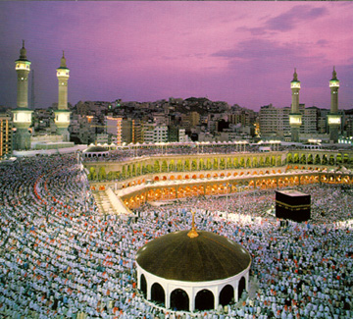
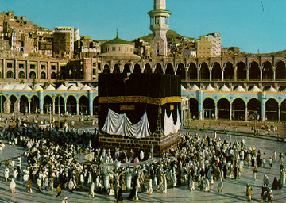
Introduction to Islam
Prepared by: Dr. Ali Elzeiny, Phd., P.E.
Assistant Professor of Civil Engineering
Quranic School Graduate
http://Zeiny.net
http://IslamMercy.net
http://answers.IslamMercy.net

Slide 2
Topics Covered
Three Spiritual Motivations
Six Pillars of Faith
Five Pillars of Worship

Slide 3
Part I:
Spiritual Motivations in Islam
Why do we need spiritual Motivations?
To fight evil temptations
To fight evil inclinations

Slide 4


Some of the Evil Temptations
The characteristics of the Evil Soul, such as excessive selfishness and greed

Slide 5
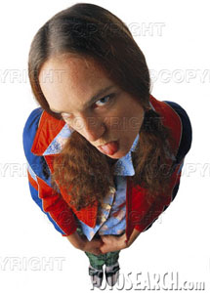
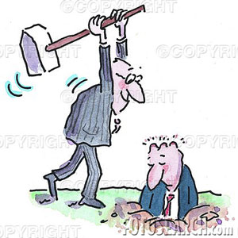
Hatred and Grudges
Ego and Arrogance

Slide 6

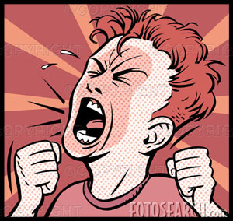
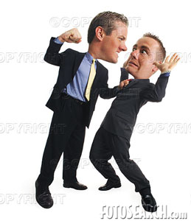
Anger and Revenge

Slide 7
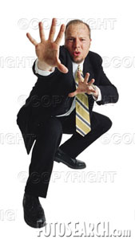
Envy and Jealousy
Cowardness

Slide 8

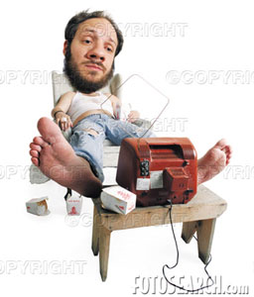
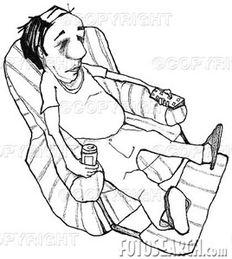
Stinginess and excessive Love of Money
Laziness

Slide 9

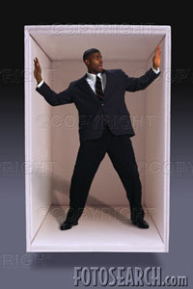
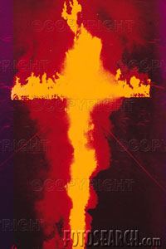
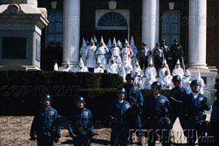

Evil Desire of Racism

Slide 10
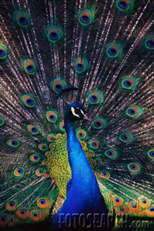
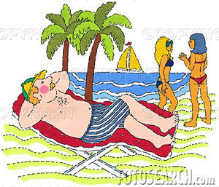

sexual desires outside of Marriage
Excessive Self Admiring

Slide 11
Three Spiritual Motivations
Love of God and Strong Desire to Please him
Strong desire to Earn Paradise
Fear of God’s Punishment and Strong Desire to Protect Oneself Against
Analogy:
What Motivates an Individual to Go To Work?
Love of His job
Desire to Earn the Salary
Fear of Being Fired, or Fear of Poverty

Slide 12
To Fight Evil Inclinations
Do and support what is right even if
It causes pain
It requires sacrifice
You hate it
Against your materialistic benefits
Stop yourself from doing what is wrong and condemn it even if
It causes pleasure
You love it
Brings materialistic benefits to you

Slide 13
Motivate you to Sacrifice for the Sake of God
Sacrifice precious time, money and effort for the sake of God
Do not expect any worldly gains, such as recognition, fame or materialistic gains
Look only to be rewarded by God in the day of judgment
Invest precious time, money and effort with God for the eternal retirement

Slide 14
Part II:
Six Pillars of Faith
1. To believe in God:
One God, the one Worshiped by Abraham, Moses, Jacob, Noah, Josef, Jesus …etc
Perfect God, i.e. does not need to rest, does not make mistakes, all knowing, in full control, and has all the attributes of beauty and greatness. FLAWLESS.
Did not beget nor was he begotten
The Big Boss
Not being able to see him ≠ does not exist, signs of his existence are every where

Slide 15
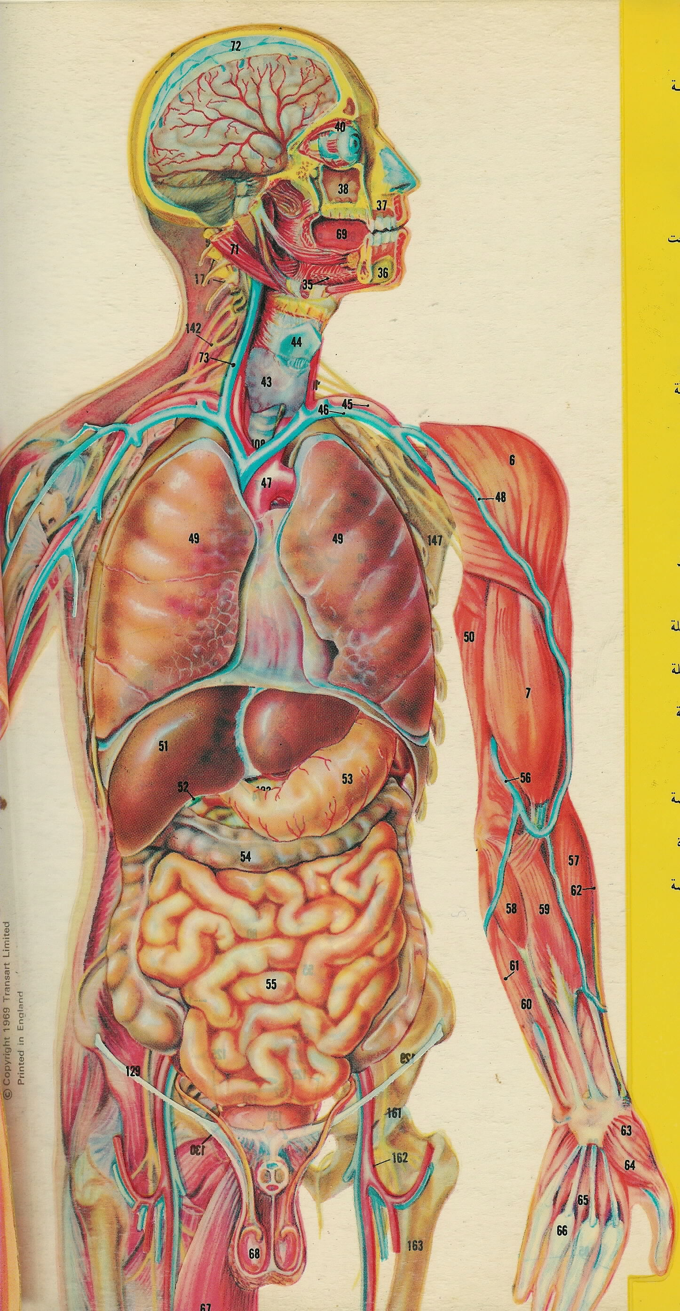
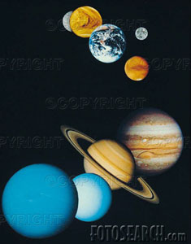


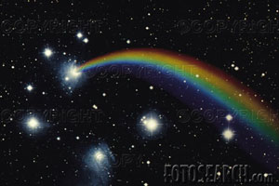
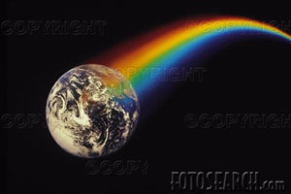
Signs of God Existence

Slide 16
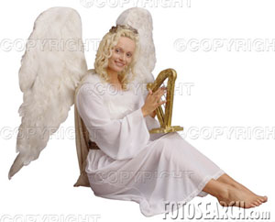
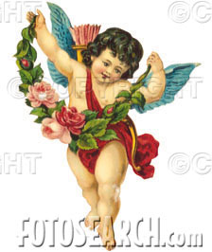
2. To Believe in the Angels of God
The Almighty Powerful King should have servants to carry on his orders and commands
Created from Light
Do not have a free will to obey or disobey
No reward or punishment to them
Satan was not an angel, he was from the Jinn created from fire
They are neither male or female and they do not look like that

Slide 17
3. To Believe in the Messengers of God
They are teachers sent by God to teach the guidance of God and answer the questions:
What is good, what is evil, what is right, what is wrong, what is moral and what is immoral?
What is the purpose of our creation?
Is there a God? Who is God?
What is God expecting from us?
What should we expect from God?
Is there a life after death? Where do we go?

Slide 18
Purpose of Life
All creation of God worship him without a choice. They can not choose not to worship him with the exception of human and Jinn kinds
God created us and gave us free will to worship him with our choice. Worship even though we have the choice not to worship, obey even though we have the choice not to obey, sacrifice for his sake even though we have the choice not to, fight our evil desires and inclinations, even though we have the choice not to fight them, actually it is easier not to, but no pain, no gain
This is why we were inspired with both good will and evil desires, so we have a free will
Angels are inspired only with good will, so they do not have a free will and they always choose good. Consequently, they do not get rewards or punishments
Satan kind is inspired only with evil desires, so they do not have a free will and they always choose evil. Satan has lost the free will after failing the test of submission by refusing to bow down to Adam

Slide 19
Meaning of the Word Muslim
“Muslim” means “submissive”, which means submissive to the guidance of God, not submissive to evil desires and evil inclinations
This life is a test of submission. Those who pass the test are those who are submissive to the guidance of God, sacrifice time, money and effort for his sake, and fight their evil desires and inclinations
By doing so, they have fulfilled the purpose of their creation and worshiped God by free will
God created us because he wanted to be worshiped by a creation that has a free will

Slide 20

Chain of the Prophets
Adam
All Prophets came with same message and taught the same guidance
Idris
Noah
Lot
Hud
Abraham
Jacob
Muslims believe in all the Prophets without making any discrimination among them. They are all equally loved and respected
Joseph
Moses
David
Solomon
Isra
John
Jesus
Mohamed
Prophets are sent as mercy to human kind to take them out of darkness and to bring them to light

Slide 21
4. To Believe in the Scriptures (Books) of God
Teachers (Prophets) were teaching from a text book called “Holly Scripture”
Prophets leave scripture to guide people and inspire them after their death
Scriptures are the word of God
Muslims believe in all original scriptures including; Bible, Torah (Old Testament), The books of Moses, David and Abraham

Slide 22
Islam and Christianity
Islam is the only non Christian based religion in the whole world that requires believers to believe in Jesus and the Bible
Believing in Jesus and the Bible is among the pillars of faith. Thus, (s)he is not a Muslim if (s)he does not believe in either Jesus or the Bible
Muslims do not believe the Bible is 100% accurate because of translation issues and existence of different versions of the bible, e.g. Catholic Bible is seven more books than King James Version, however, Muslims believe in the portion of the Bible confirmed by the Holly Quran

Slide 23
Dictionary Game
Language A
Translator 1
Translator 3
Language C
Language B
Translator 2
Because each translation is an interpretation, you start the game with one sentence in language A and end up with a totally different sentence

Slide 24

5. To Believe in the Day of Judgment
People will be resurrected and judged for their deeds by God
If there is no day of judgment, then Hitler is having the same fate like Abraham, both are equally peacefully sleeping in their graves
Criminals got away with their crimes
People with Good will are losers because they have sacrificed for nothing
Why should I sacrifice precious things if I am not expecting any reward back

Slide 25
6. To Submit Yourself in Full Acceptance of God’s Decisions
Many decisions are made by God, such as sex, color, race, birth place, choice of parents, family, …etc
Must trust and respect God’s choices for you
Can not question or look down to God’s decisions
Can not look down to a person because of his color or race, it is the choice of God. Islam is COLOR BLIND religion

Slide 26
Trust God’s Decisions Even if you Can’t Understand them or Look Harmful to You
God’s ways are above our ways, his thoughts are way above ours and his wisdom is way above ours
Why did I get this cancer?
Why did I loose my family in a car accident?
It is okay to feel sad, but never think that God has been mean to you
I am sad, but I still love you and respect your will and wisdom, and I will continue to worship you

Slide 27
Part III:
Five Pillars of Worship
Worship is the practice of faith
Faith without practice is not accepted
It is hypocrisy to believe in a certain way and to act in an opposite manner
God in the Koran never talks about those who believe, but always those who believe and act accordingly

Slide 28
1. To declare that there is no Deity but God and Mohamed is his Messenger
It is a quick way to renew the faith and remove the forgetness of God
As we engage in materialistic life, we forget God
Islam requires the frequent remembrance and consciousness of God
Remembrance of God keeps the spiritual motivations up

Slide 29
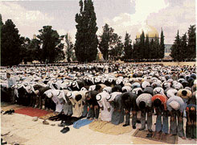
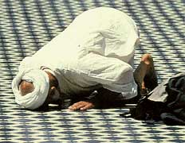
2. Pray Five Times a Day
1) Dawn Prayer before Sunrise
2) Noon prayer 4) Sunset Prayer
3) Afternoon prayer 5) Night Prayer

Slide 30
Why do we pray
Phone call to God to thank him for all the blessings that he is providing to us, i.e. perform the worship of gratitude
Maintain God’s remembrances
Keep up the spiritual motivations
Prevent sins

Slide 31
3. Fasting Ramadan
Spiritual exercise to train the spiritual muscle of self control
Submission to God, we are in control of our evil desires, not they are in control of us
Test of submission, do what God order even if it causes pain to us
What if I sneak to the kitchen and eat?
Remember those who have 24 hours a day seven days a week Ramadan
IF I can fast from lawful things, can’t I fast from unlawful things

Slide 32
4. Alms Giving. Pay the Obligatory Charity
2.5% of wealth in excess to your needs must go to the poor and needy, not to the hungry administrators
20% of mines and oil
10% if crops irrigated by natural rain, or 5% irrigated by artificial ways. Must be paid on the day of harvest
Watch for Charitable organization overhead
Can’t go to the funds of the Islamic Centers
Can be used to free slaves, if any

Slide 33
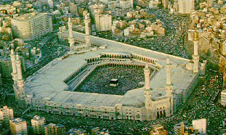
5. Pilgrimage to Makkah at Least Once in Life Time
Only to those who can afford it and healthy enough to make the journey
Annual conference to all Muslims
People travel for pleasure and business. This trip is travel for the sake of God

Slide 34
Divine Law of Islam
Humans must have a law to govern their life
No civilized society can live without laws and constitution
The law is either divine or man made. Those who refuse divine laws, the only alternative is man made law
Muslims chose the divine law and divine constitution, which is Koran

Slide 35
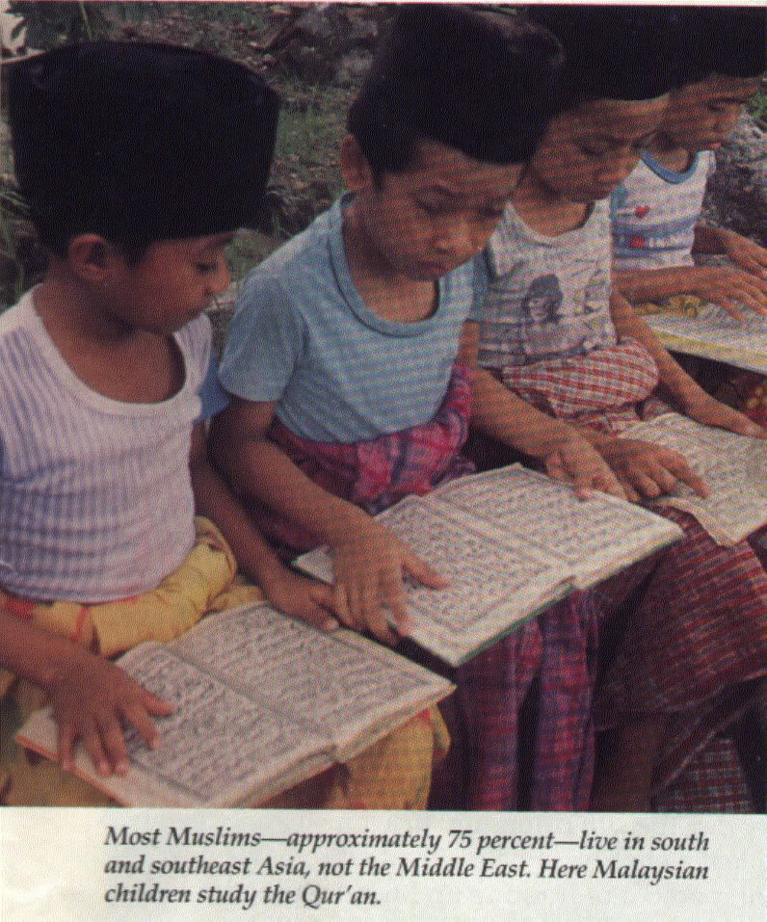
Numerical Facts About Muslims

Slide 36
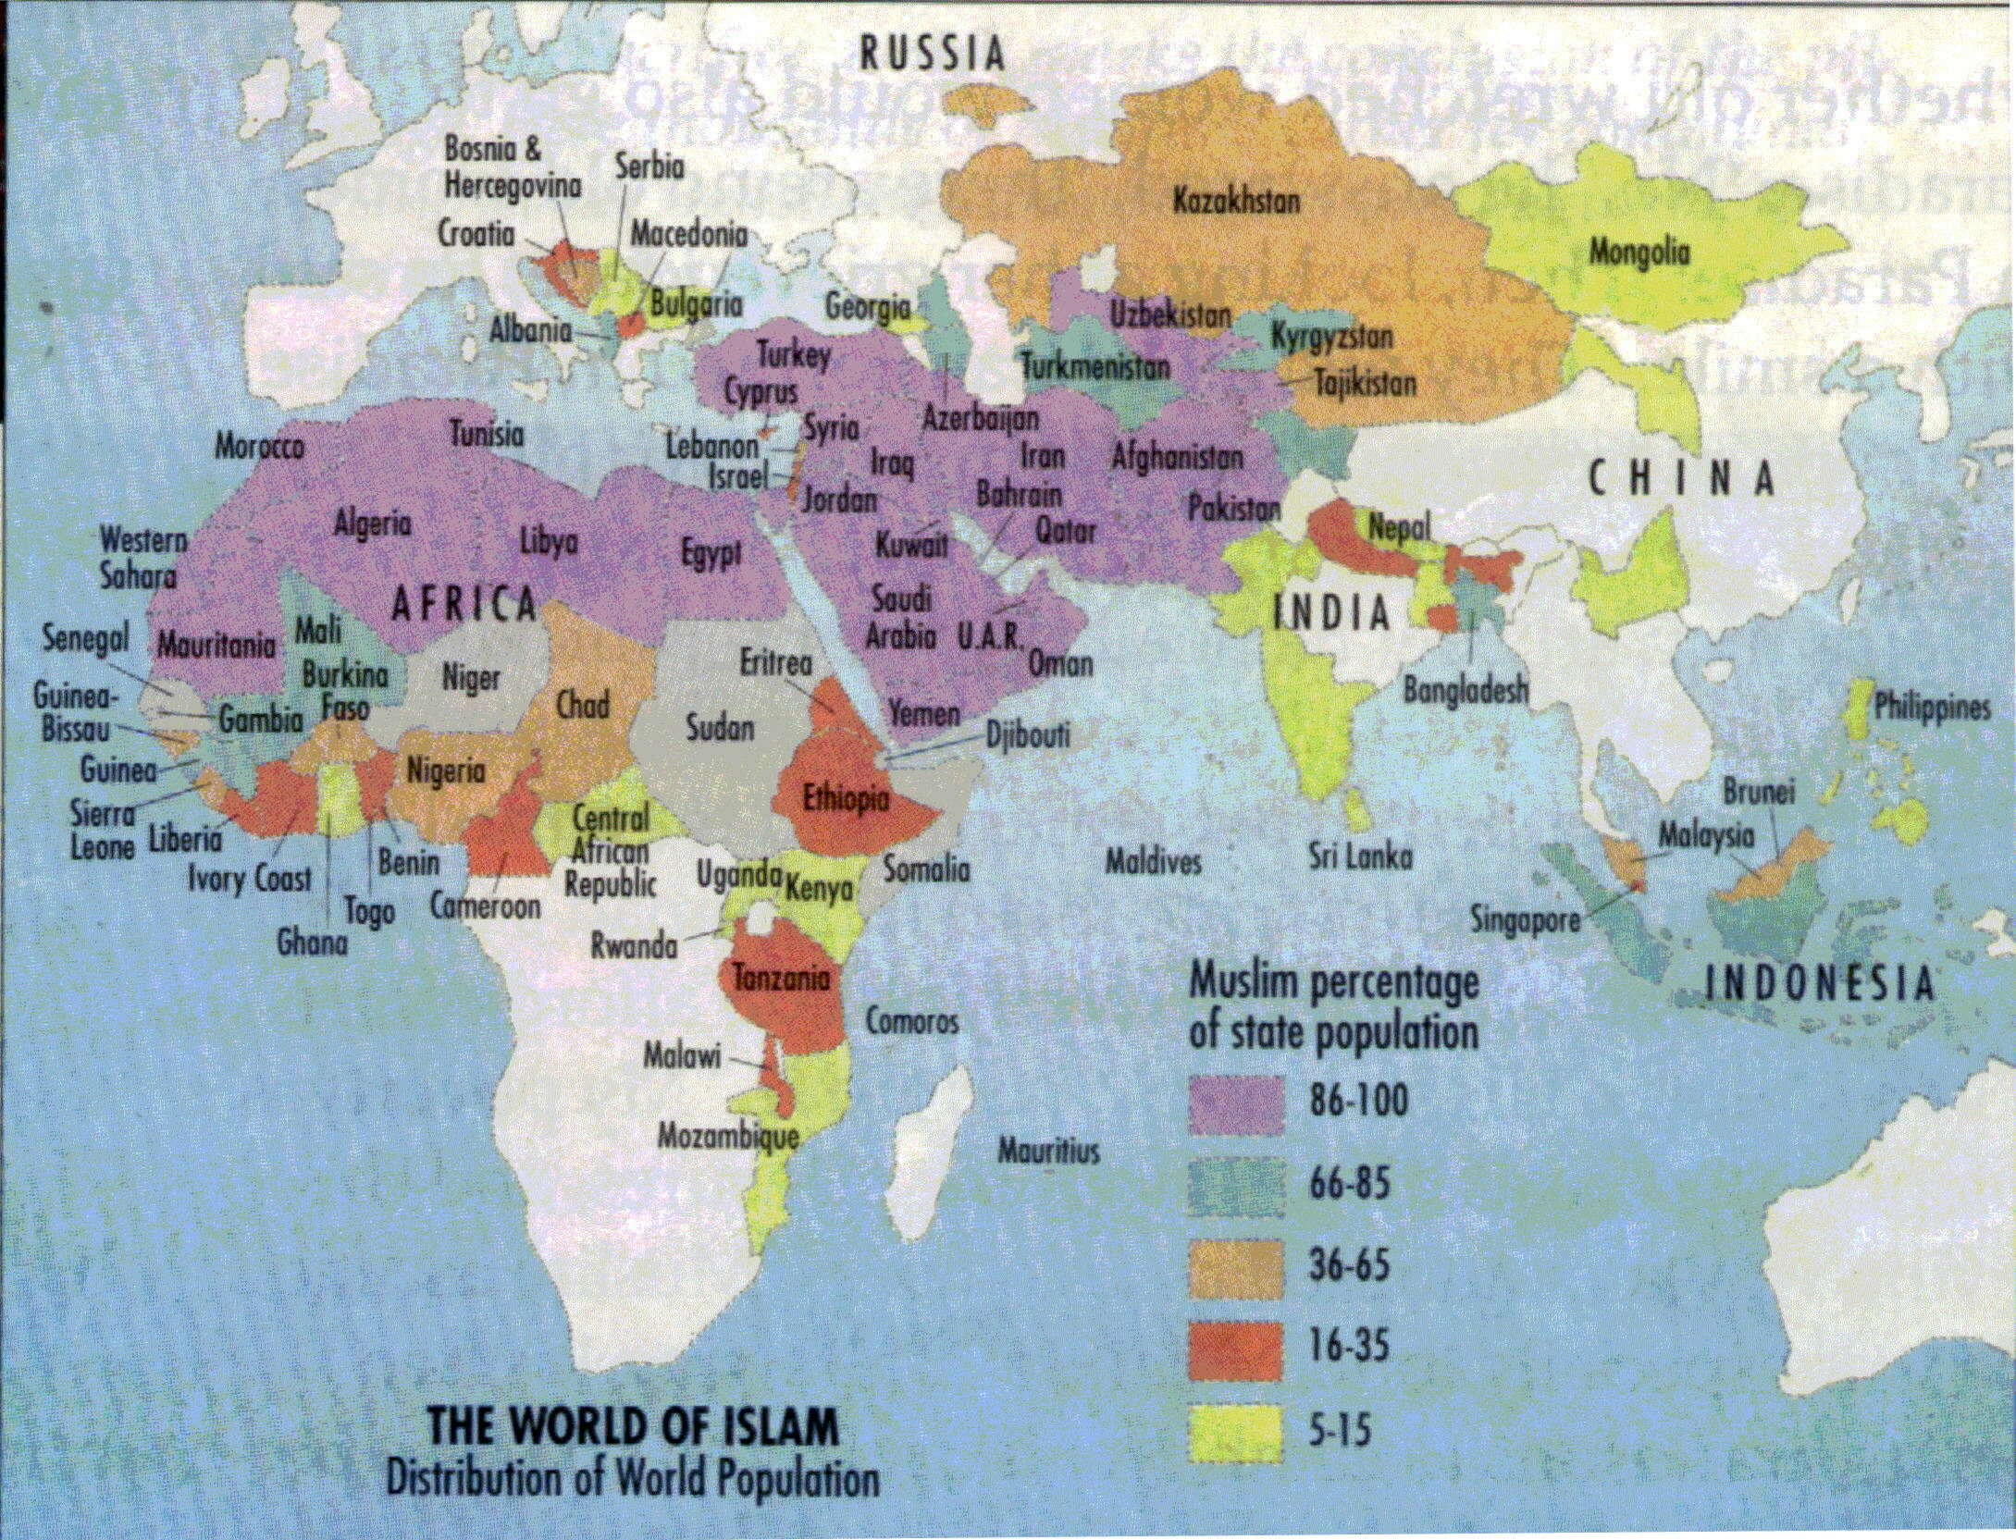
Total 1500 Million Muslims
Only 250 Million Speak Arabic (17%)

Slide 37
Questions
http://Answers.IslamMercy.net
Answers@IslamMercy.net

