Slide 1
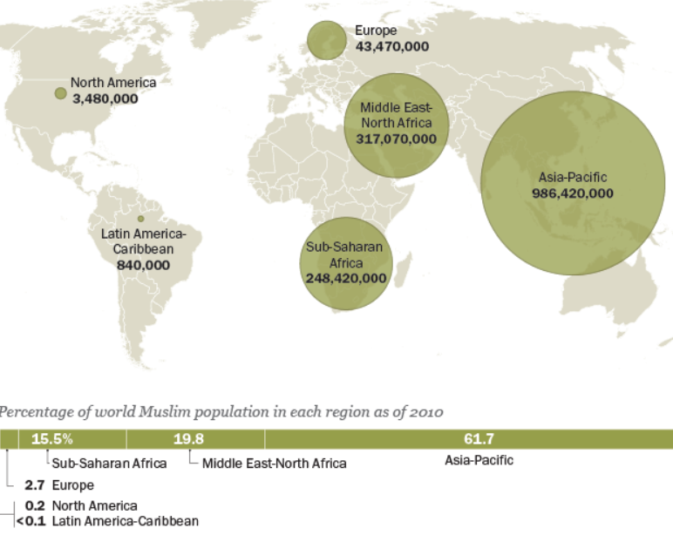
General Information about Islam
Population of Muslims
As of 2010, there were an estimated 1.6 billion Muslims around the world
62% of Muslims live in the Asia-Pacific region.
344 million Muslims live in India and Pakistan.
Indonesia has the largest Muslim population in the world, with approximately 225 million.
Arab Muslims are about 20% of the total Muslim population.
http://Answers.IslamMercy.net
Answers@IslamMercy.net

Slide 2
What is Islam?
The word "Islam" is an Arabic word which means "submission to the will of God". This word comes from the same root as the Arabic word “Salam” , which means “Peace". As such, the religion of Islam teaches that in order to achieve true peace of mind and surety of heart, one must submit to God and live according to His Divinely revealed Law.
Who is Allah?
Allah is the Arabic word for “ The God”. It has been used in the Arabic bibles as well.
Allah is not God of Muslims only. He the God of everyone.
He is God of all creations, because He is their Creator and Sustainer.
Muslims believe that the Muslims, the Christians and the Jews are worshiping the same God.

Slide 3
Three Spiritual Motivations in Islam
Love of God and strong desire to please Him.
Strong desire to Earn paradise.
Fear of God’s punishment and strong desire to protect oneself against.
Analogy
What Motivates an Individual to
Get Up and Go To Work?
Love of her job.
Desire to earn the income and the benefits.
Fear of being fired, or fear of Poverty.
Motivates us to Sacrifice for the Sake of God:
Sacrifice precious time, money and effort for the sake of God.
Look God’s reward in the Day of Judgment.
Shouldn't seek worldly gains, such as recognition, fame, ….etc. They are welcome to come, but they shouldn’t be the main intended target.
It is similar to invest precious time, money and effort with God for the eternal retirement.
Motivates us to Fight Our Evil Temptations and Lower Desires Even if
It requires sacrifice.
We like them so much.
Against our benefits.

Slide 4
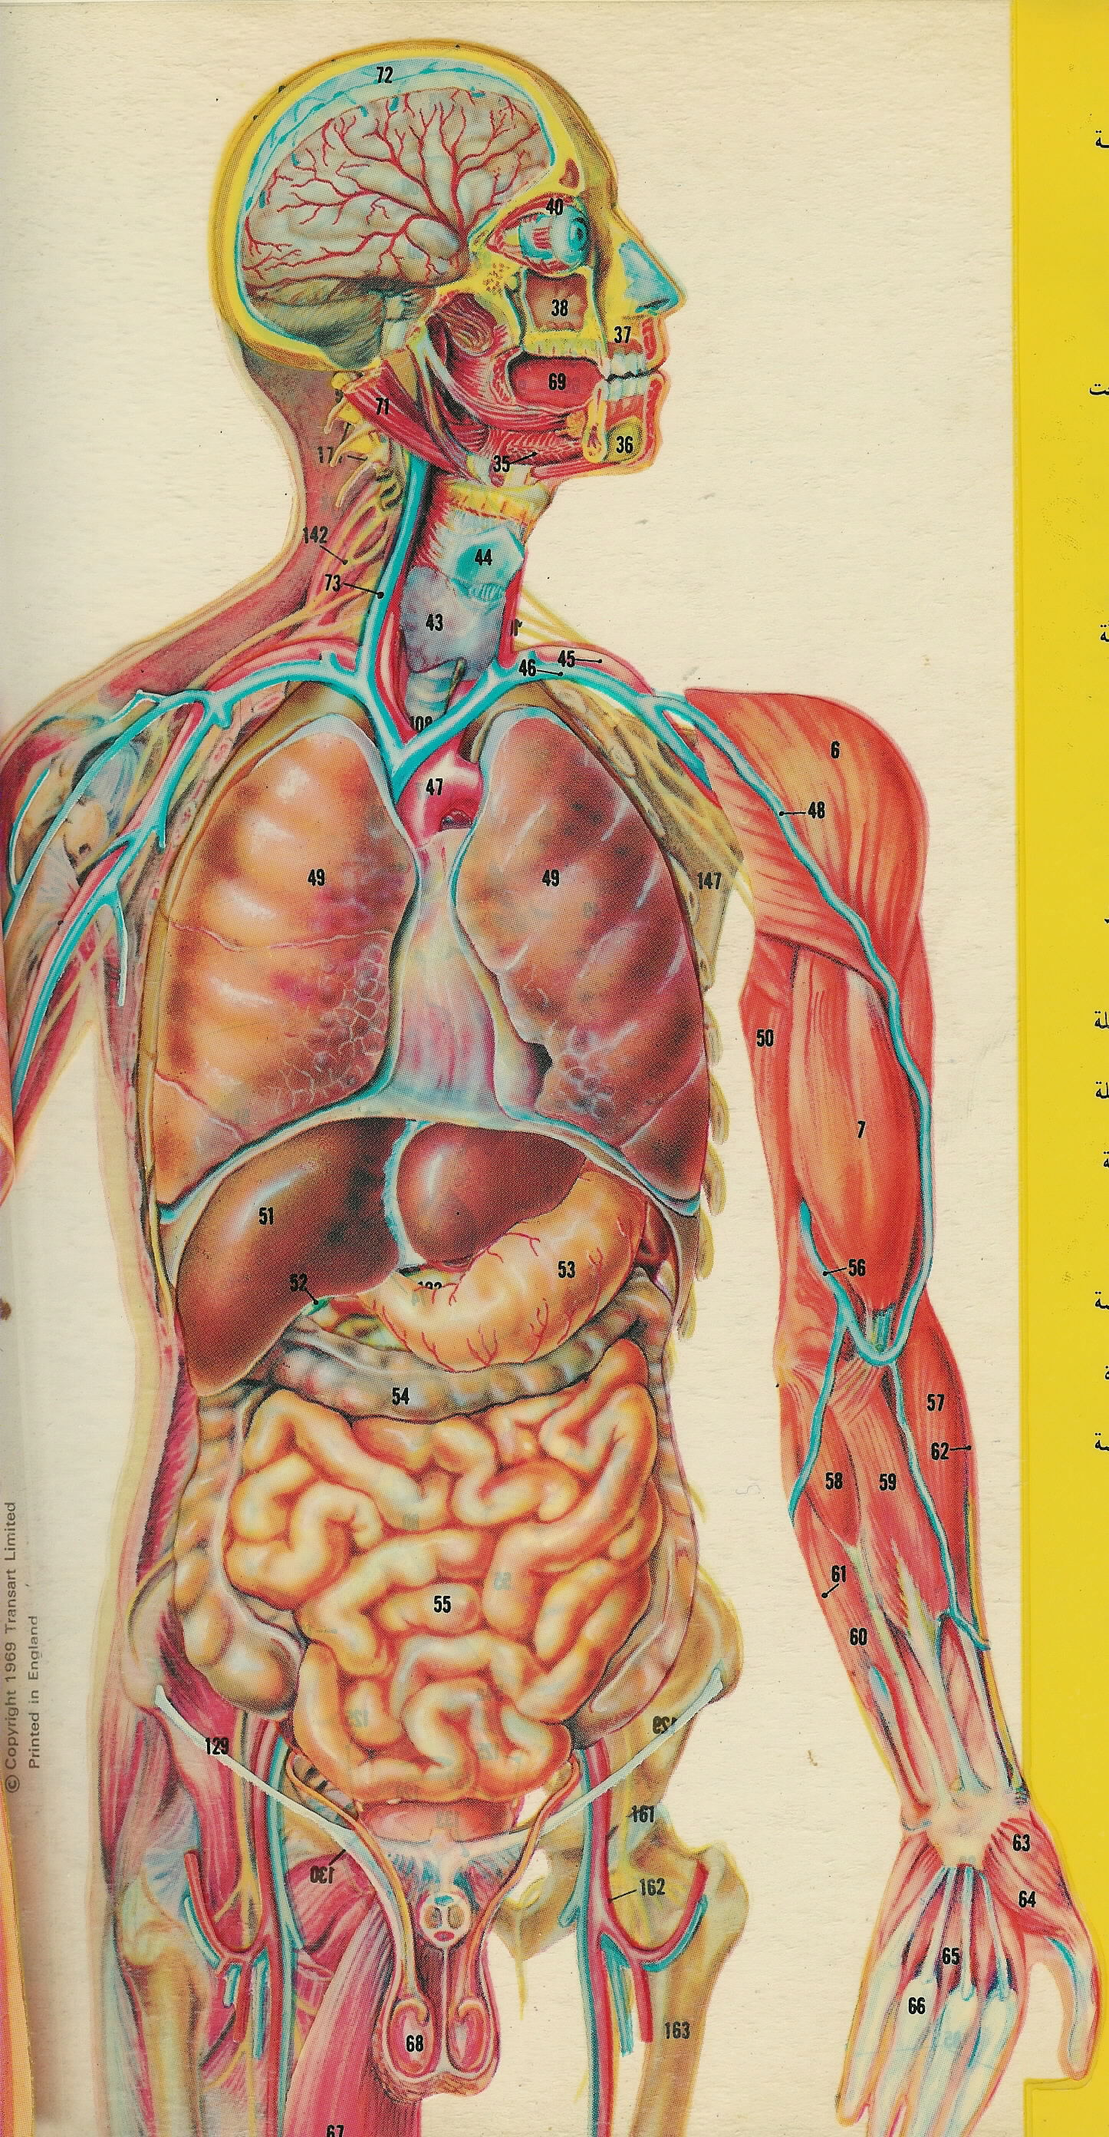
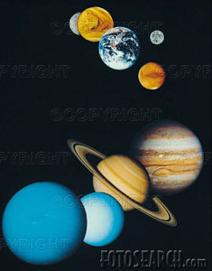
Six Pillars of Faith:
1. To believe in One God, Who is
Not separated into units or roles. The One Worshiped by Abraham, Moses, Jacob, Noah, Josef, Jesus …etc.
Perfect God, i.e. does not need to rest, does not make mistakes, all knowing, in full control, and has all the attributes of beauty and greatness.
Doesn’t have a father, a son, a daughter, a wife, a super-God, a co-God or a sub-God.
Not being able to see God does mean that He doesn't exist, signs of His existence are every where. We see Him by our brains.
Has 99 Names such as, The
Almighty | Helper | Master | Highest
Beautiful | Hidden | Merciful | Kind
Beginner | Holy | Needless | Nice
Ending | Infinity | Powerful | One
Flawless | Judge | Rich | Peace
Forgiver | Just | Supplier | Reliever
Friend | King | Unit | Ruler
Full of Life | Knowledgeable | Victorious | Supporter
Generous | Loving | Wise | Observer
Glorious | Maker | Hearer | Limitless

Slide 5
2. To believe in The Angels:
The royal way to do things is to have servants do it.
The Almighty Powerful King should have servants to carry on his orders and commands.
It is not appropriate for His Majesty to do Every thing by himself.
Angeles were created from Light.
Angeles are genderless.
Angeles do not have a free will to obey or disobey.
Angeles do not get reward or punishment.
Satan was not an angel, he was from the Jinn kind created from fire.
3. To Believe in the Messengers and Prophets of God:
They are teachers sent down by God to guide the people, set expectations, and establish morals.
They answer important life questions such as,
What is the purpose of our creation?
Is there a God? Who is He?
What is God expecting from us?
What should we expect from God?
Is there a life after death? Where do we go?
4. To Believe in the Scriptures (Books Sent Down by God:
Teachers (Prophets) were teaching from a text book called “Holy Scripture”.
Prophets leave scripture to guide people and inspire them after their death
Scriptures are the word of God
Muslims believe in all original scriptures including; Bible, Torah (Old Testament), The books of Moses, David and Abraham

Slide 6
5. To Believe in the Day
of Judgment:
6. To Accept and Respect God’s Decisions (Believe in Fate):
People will be resurrected
and judged for their deeds
by God.
If there is no day of judgment, then Hitler is having the same fate like Abraham, both are equally peacefully sleeping in their graves.
If there is no day of judgment, then criminals got away with their crimes.
If there is no day of judgment, then Good people might be looked at as losers because they have sacrificed for nothing.
If there is no day of judgment, then Why should we sacrifice precious things if I am not expecting any reward back.
Many decisions are made by God, such as gender, color, race, birth date and place, choice of parents, family, …etc.
Must not punish or persecute people for natural differences intended by our creator, such as religion, color, race, …etc. Islam is a color and a race blind religion.
Must trust and respect God’s choices for us. Can’t question or look down to God’s decisions. Must Surinder to the will of God.
God’s ways are above our ways, his thoughts are way above ours and his wisdom is way above ours as well.
It is okay to be sad after a tragedy, but it is not okay to reject the will of God or accuse him of being cruel or mean. Even if you do so, this will not change the reality.

Slide 7
Purpose of Life in Islam:
Why does God Allow Evil to Happen?
All creation of God worship him without a choice. They are controlled by the laws of nature. They can not choose not to obey. The except is made to Human and Jinn kind.
Although Human and Jinn have free choices, but they are still controlled by the laws of nature as well. They age, die, get ill and whatnot.
God created us and gave us free will to worship him with our choice. Worship even though we have the choice not to worship, obey even though we have the choice not to obey, sacrifice for his sake even though we have the choice not to, fight our evil desires and inclinations, even though we have the choice not to fight them. Actually it is easier not to, but no pain, no gain.
Satan kind is inspired only with evil desires, so they do not have a free will and they always choose evil. Satan has lost the free will after failing the test of submission by refusing to bow down to Adam.
If there are no evil deeds, then good deeds will not exist.
Evil deeds must exist to brings out the goodness so that Good people can distinguish themselves by doing good deeds and staying away from bad deeds.
We have to have an alternative so that we can make choices, i.e. free will.
Why does God Allow Bad Things to Happen to Good People?
Because of the laws of nature. No one is excluded from them. Like everyone else, good people may have accidents, diseases, age, die …etc.
The reward of being good is not in this life. It is in the life to come. We may get a taste of the reward in this life.
The punishment is also in the life to come. What we see in this life is just a taste of the punishment.

Slide 8
Five Pillars of Worship
2. Pray Five Times a Day
(1) Dawn prayer before sunrise.
(2) Noon prayer. (3) Afternoon prayer.
(4) Sunset prayer. (5) Night prayer.
Worship is the practice of faith.
Faith without practice is not accepted.
It is hypocrisy to believe in a certain way and to act in an opposite manner.
God in the Quran never talks about those who believe, but always those who believe and act accordingly.
Why do Muslims Pray?
(1) Imagine you have a child that attends an out of state school. You send him the check and he doesn’t call you to say thank you and he kept ignoring calling you. You get mad and call him and ask him “why didn’t you call me to thank me for the check”, he replied “I thank the mail person for the check. He is the one that I see handing me the check”.
Although we don’t see God handing us our supplies, but we know they come from Him. It reaches us through natural means that he established (like the mail person). The prayers are the five daily phone calls to thank God for His supplies.
(2) It maintains the remembrance of God in our hearts. This keeps God consciousness and the spiritual motivations alive in our heart.
To declare that there is no Deity but God and Mohamed is His Messenger
As we engage in our daily life, we may forget God.
It is a quick way to renew the faith and remove the forgetness of God.
Islam requires the frequent remembrance and consciousness of God.
Remembrance of God keeps the spiritual motivations up.

Slide 9
3. Fasting Ramadan
In one month on the lunar calendar, called Ramadan, Muslims worldwide fast from dawn to sunset. They abstain from drinking, eating and intimacy. The Sick and weak are exempted.
Ramadan is a training camp for the following:
Spiritual exercise to train the spiritual muscle of self control.
Test of submission to God, we are in control of our temptations, not being controlled by them. Do what God order even if it causes pain to us.
Consciousness of God. if one sneaks to the kitchen and eat, no one would know.
Remember the poor who fast 24 hours a day seven days a week for lack of food.
If I can fast from lawful things, can’t I also fast from unlawful things. If I can deny my needs, I can also deny my wants.
Establish new habits.
4. Alms Giving
Pay the annual obligatory charity as follows:
May not go to the funds of the Islamic centers and organizations. Those can be funded by general charity, not Alms.
2.5% of wealth in excess to your needs, i.e. savings.
20% of mines and oil.
5-10% if crops. Must be paid on the day of harvest.
May be given to poor and needy, free slaves, ransom prisoners of war, provide to travelers who run out of supplies, treat needy patients and for the sake of God.
5. Pilgrimage to Makkah at Least Once in Life Time (Hajj).
Only to those who can afford it and healthy enough to make the journey.
People travel for pleasure and business. This trip is a travel for the sake of God. Hajj is like an annual conference to all Muslims from different places and nations to share concerns and news.
Equality is emphasized in Hajj because regardless of race, color, wealth or social status, all Muslims in Hajj wear the same cloths, walk on the same ground, have the same restrictions and perform the same rituals.

Slide 10
The Commandments in Islam from the Quran (17:23-39) and (5:45)
Worship Non but God and don’t take partners or middle Gods beside him.
Be kind to the parents, especially when they become old. Don’t say a word that would offend them and don’t rebuke them. Pray for them by saying “O God, give them from your mercy for they brought me to life and have raised me while I was a child”.
Don’t be stingy and don’t be extravagant for they are wrong doers.
Don’t kill your children out of fear of poverty. God will provides for you and them.
God may give or hold for a wisdom known to him, for he knows his servants very well.
Don’t approach adultery or fornication, for they are so evil.
Have a clean heart free of evil. For God is well aware of what is in your heart.
Sincerely repent, for If you do that, then God will forgive you.
Don’t take the life that God made sacred except for a lawful cause. The family of the victim are given the right to seek revenge and damages.
Don’t take the money of the orphan except to improve it. Give him/her back his/her money when (s)he becomes an adult.
Be just and fair when you weigh during trading, and don’t cheat.
Don’t seek knowledge that you are not entitled to know. For God will judge you for what you hear, what you see and what is in your heart.
Don’t walk on the earth with insolence, for you are not as tall as the mountains and you are not going to destroy the earth.
If you seek other Gods beside God, you will be thrown in hell and will have sever humiliation and sorrow.
Life for life, eye for eye, nose for nose, ear for ear, tooth for tooth and injuries for equal injuries unless the victim or the family forgives.

Slide 11
Questions?
http://Answers.IslamMercy.net
Answers@IslamMercy.net

